Slide 1
Shippers’ Forum
8 June 2023

Slide 2




MUTE YOUR MICROPHONE, WHEN YOU DON’T SPEAK
SWITCH ON YOUR CAMERA, ONLY WHEN YOU ARE GIVEN THE WORD TO SPEAK
USE THE ‘RAISE HAND’ FUNCTION IF YOU WISH TO COMMENT OR ASK A QUESTION…
…YOU CAN ALSO WRITE YOUR QUESTION USING THE CHAT - THE HOST WILL ASK THE QUESTION FOR YOU

Slide 3
PROGRAM
13:00 Welcome – Clement Johan Ulrichsen, Energinet
13:05 Danish Energy Agency – Jane Glindvad Kristensen, Danish Energy Agency
13:25 Gas Storage Denmark – Marni Jacobsen, Gas Storage Denmark
13:40 Market report – Peter Lyk-Jensen & Frederik Nilausen Dam, Danish Utility Regulator
14:00 REMIT obligations – Søren Søndergaard, Danish Utility Regulator
14:15 BREAK
14:30 Tariffs – Jeppe Danø, Energinet
14:45 Data and Balancing – Christian Rutherford, Energinet
15:00 Capacity – Christian Rutherford, Energinet
15:15 Final Remarks – Clement Johan Ulrichsen, Energinet

Slide 4

Welcome
Clement Johan Ulrichsen, Energinet

Slide 5
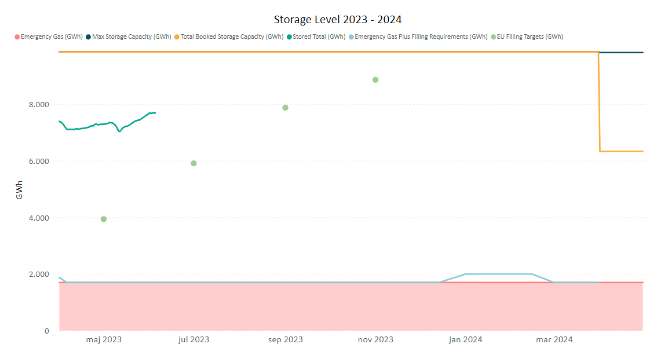
Danish gas storage filling
Individual filling requirements 2023-2024
Tender on 31 May 2023
0,3 TWh purchased
Price of 2,8 €/MWh
Total cost of 6.3 million DKK
More information:
Market-based Activity (energinet.dk)

Slide 6

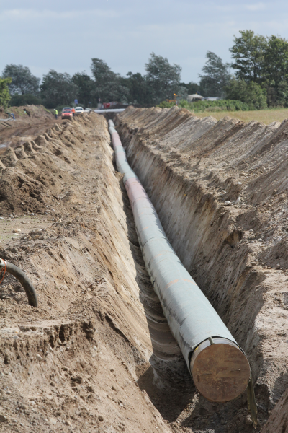

OWNERSHIP AND OPERATION OF THE DANISH PIPELINE-BOUND HYDROGEN INFRASTRUCTURE OF THE FUTURE
Clarification on the roles of Energinet and Evida in the hydrogen system
New political agreement on ownership and operation of hydrogen infrastructure gives Energinet and Evida a key role in the development of pipeline infrastructure that can support the hydrogen economy of the future.
The role of Energinet is:
•To connect cross-border piped hydrogen infrastructure to a Danish receiving point,
•To connect offshore pipeline hydrogen infrastructure and cross-border hydrogen pipelines across the country to a hydrogen storage, a so-called backbone,
•To carry out the task as responsible system operator.
The role of Evida is
•To connect domestic hydrogen producers and consumers,
•To connect the above to an interconnected hydrogen system.

Slide 7
Contact: cju@energinet.dk

Slide 8
Status on Security of Supply
8th June 2023
Head of Division, Jane Glindvad Kristensen

Slide 9
General status on supply
Energy systems are connected and affect each other

Slide 10
Supply situation
PAST WINTER (22/23)
NEXT WINTER (23/24)
GAS
Stable supply.
Volatile prices. Reduced gas from Russia. Increased LNG. Reduced use.
Challenging.
Energy savings are still important.
ELEC.
Stable supply.
Volatile, high prices. Low production. Slightly reduced consumption.
Challenging.
Low production in Europe.
OIL
Stable supply.
High prices.
Expected stable.
Focus on consequences of EU sanctions.
HEAT & BIOMASS
Stable supply.
Higher prices.
Stable supply.
Notes:
Opmærksomheds-punkter:
EL:
Forbrug
Vandkraft i Norge
A-kraft i Frankrig, Sverige og Finland
Elforbindelser i Norge
”Ny” kapacitet i nabolande
GAS:
Forbrug
Gasmarkedet
Baltic Pipe
Gaslagre
OLIE:
Diesel
Konverteringer fra gas til olie
VARME OG BIOMASSE:
Forbrug
Biomasseleverancer (indv.)

Slide 11
Gas Supply
Status and next winter

Slide 12
Stable gas supply
Danish gas storage is nearly 80 pct. full
39% bio gas in the Danish gas system in past 12 months
Gas field Tyra reopens in winter 23/24
Prices has been high. Currently moderate to low.
Less Russian gas, but much more LNG in Europe
But gas reduction measures are still essential

Slide 13
Forward market for gas
Current situation of expectations in the market
The market does currently not expect significant increase in prices the coming months and years.
Notes:
Omregning:
25,26 Euro/MWh
= 188 DKK/MWh
= 2,3 DKK/M3

Slide 14
Gas savings trend continues
Reduction in gas consumption*
Last 12 months:
January – April 2023:
23 pct.
24 pct.
Note: Pipeline gas, being natural gas + upgraded bio gas
Notes:
Sidste 12 måneder t.o.m. april 2023: 23 pct.
April 2023: - 28 pct. ift. normalen.
Generelt er gasforbruget reduceret i EU
Det er rigtig positivt at forbruget af gas er faldet – det stiller os rigtig godt ift. at komme gennem vinteren, også når det kommer til elforsyning.
Noget af reduktionen skyldes, at vi har haft en lun vinter. Derudover har mange at de mest gasforbrugende virksomheder omstillet til olie, hvilket bringer mig videre til næste slide.

Slide 15
”Energy savings-scenario” for gas supply
Notes:
Den indregnede reduktion er 23 % - tilsvarende de seneste 12 måneders gennemsnitlige reduktion

Slide 16
”Main scenario” for gas supply
Notes:
Opdateret

Slide 17

Update of Danish Emergency Supply Plan
SoS-Regulation (2017/1938) mandatory update of risk assessments and plans every four years.
National risk assessment: N-1 calculation incl. Tyra = 332 %
Regional risk assessment: S-1 scenario shows need of 15 pct. demand-reduction to prevent curtailment.
Emergency plan and Preventive action plan: update is currently taking place.
Process Emergency plan:
Workshops and meetings with Energinet
Stakeholder involvement – non-protected costumers, shippers, NRA, GSD
Consultation on final draft – Risk Group, neighboring countries, the public.
Consultation www.ens.dk
Ca. 6th July – 17th August

Slide 18
EU Security of Supply
Status

Slide 19
EU REGULATION on SECURITY of SUPPLY from 2022
23 MARCH
Proposal for amending SoS Regulation
20 JULY
Proposal for Save Gas for a Safe Vinter
14 SEPTEMBER
Proposal for emergency intervention on high energy prices
18 OCTOBER
Additional proposal on high gas prices and security of supply
9 NOVEMBER
Proposal to accellerate deployment of renewables
19 NOVEMBER
Proposal for a market correction mechanism
2022
27 JUNE
Adoption of Gas Storage Regulation
5 AUGUST
Adoption of Gas Reduction Regulation
6 OCTOBER
Adoption of emergency regulation on high energy prices
19 DECEMBER
Political agreement on outstanding emergency measures

Slide 20
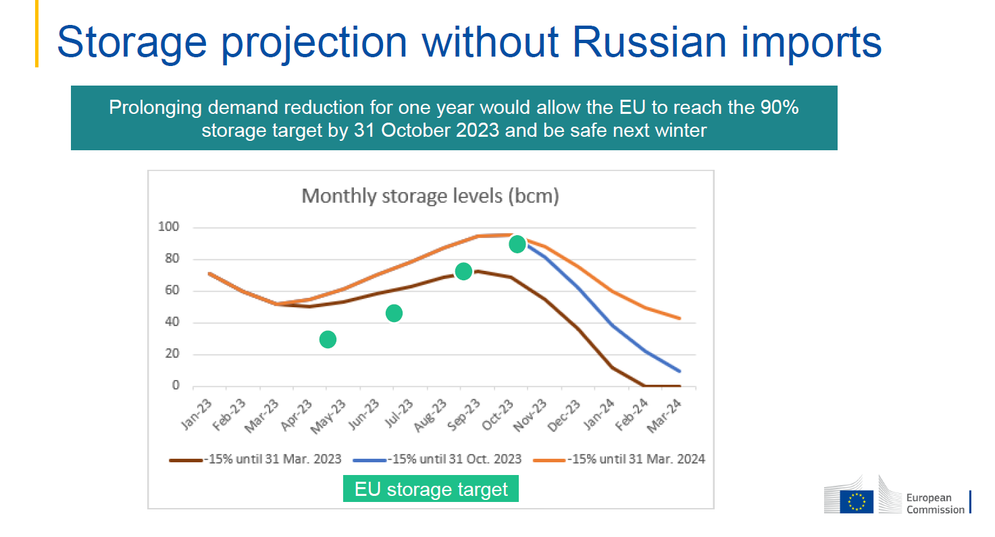
Extended regulation should ensure storage

Slide 21
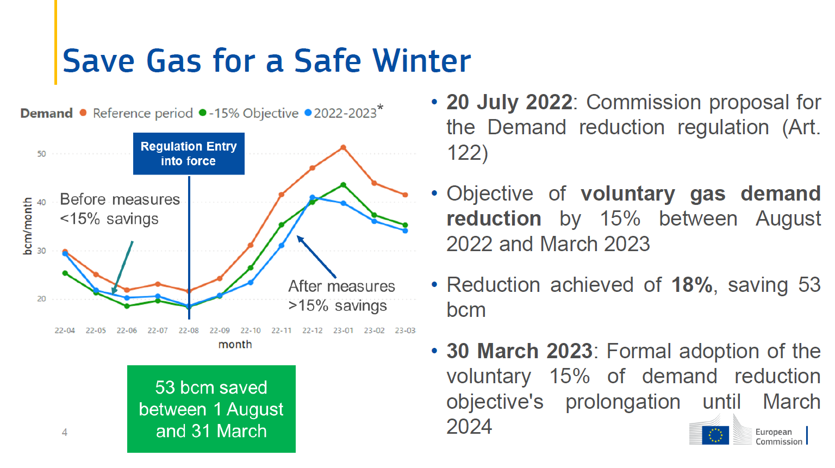
EU regulation has proved effective

Slide 22
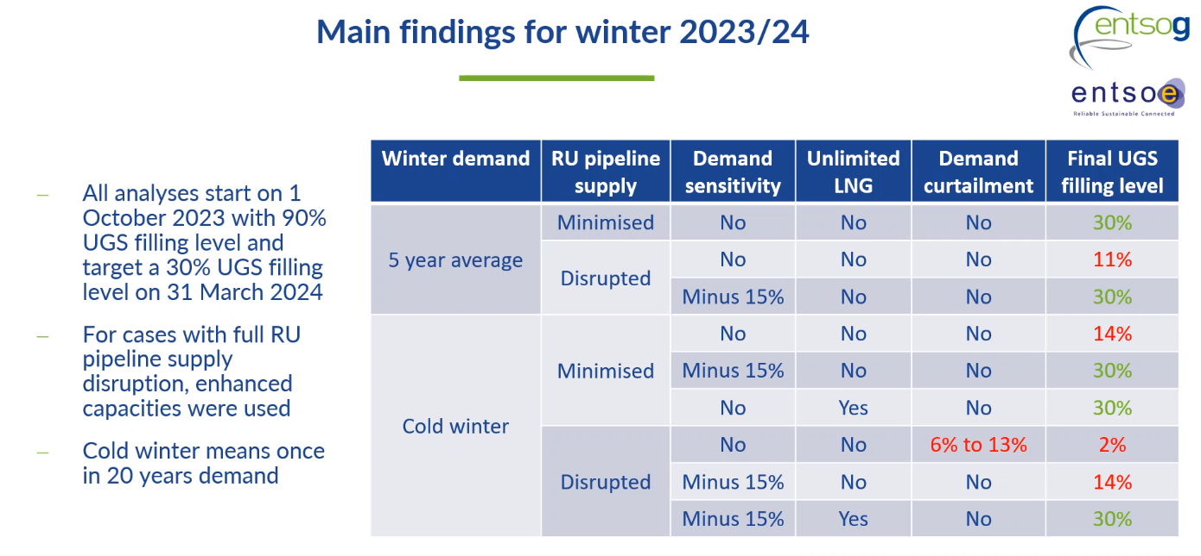
Reductions in gas use remains important for SoS

Slide 23
EU Aggregated Demand
Status

Slide 24
Aggregated EU demand
Purpose
Demand aggregation and a joint tender of gas quantities
To secure gas supply and to achieve fair prices on gas
Both gas shippers, gas traders, gas suppliers and consumers can participate
The EU Commission have agreed that Prisma will be the provider of the energy platform of joint purchases of gas , AggregateEU – both buyers and providers can register on the platform to participate
Denmark is obliged to have a demand aggregation on 15% of the stock filling requirement (1,33 TWh/year). The companies are not obliged to buy the tendered amounts of gas on the platform even though they have registered on the platform

Slide 25
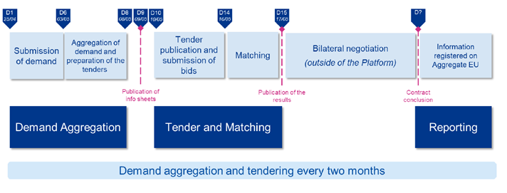
The first tender round has ended
The 25th of April – 3th of May 2023, hereafter the following matching of buyers and suppliers took place
Buyers and suppliers negotiate the contract outside the platform
101 companies have registered on Aggregate EU
Supplies: 25 suppliers, 13,4 bcm
Matched: 10,9 bcm
The tender rounds will be repeated every second month – next round will be in the end of June 2023

Slide 26

The second tender is end of June
For the second tender round, there will be some adjustments of the products that are avaible on the platform based on experiences from the first tender round
We will continue the dialogue with companies and learn from their experiences and inputs, where we will accommondate their needs
Information about cooperation between companies through a central buyer or an agent on behalf

Slide 28
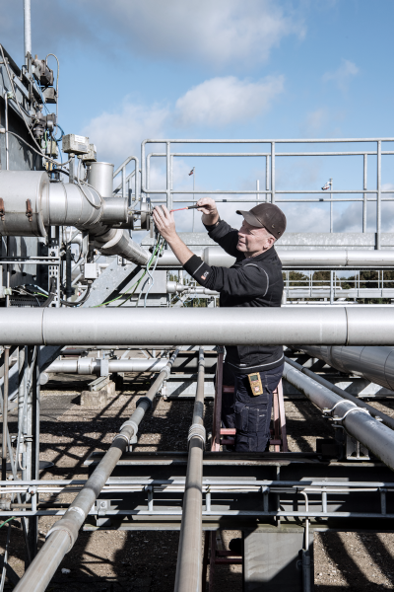

gas storage Denmark
marni jacobsen
AGENDA
Available Storage Capacity & Upcoming Auction
Adjustment of:
Reservation Price
Variable Injection Tariff

Slide 29

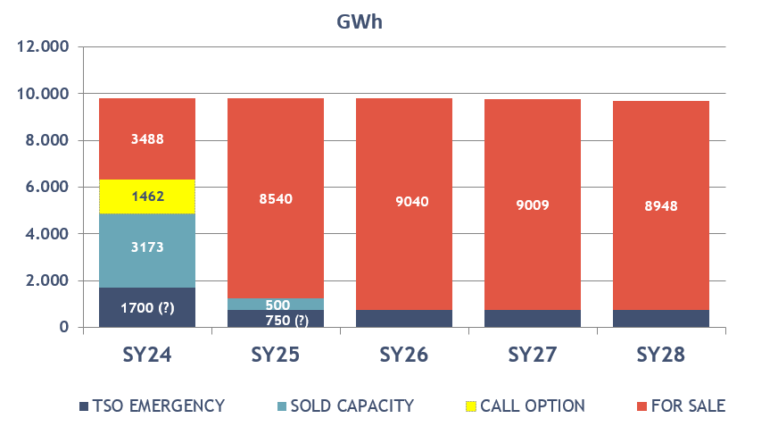
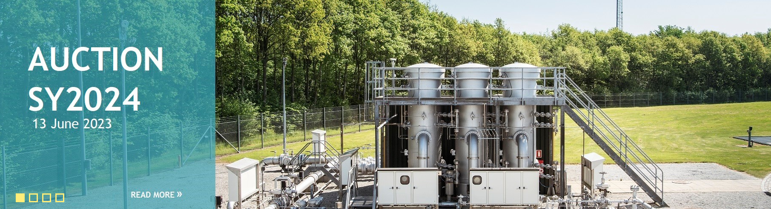
AVAILABLE STORAGE CAPACITY
1,200 GWh SY24 Capacity on Auction 13 June 2023
Pay-as-bid
Product 90/90
Delivery 1st April 2024 – 1st April 2025
Read more: link

Slide 30
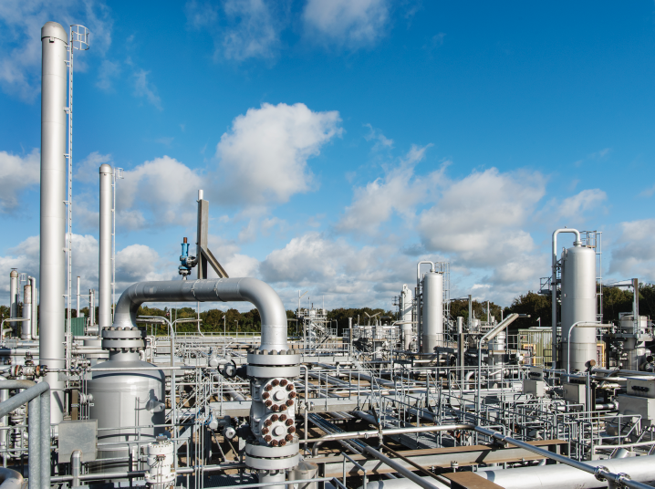
adjustment of reservation price
& variable injection tariff
Reservation Prices increase by 0.60 €/MWh:
170/170: from 3.00 to 3.60 €/MWh/year
170/85: from 3.50 to 4.10 €/MWh/year
90/90: from 3.62 to 4.22 €/MWh/year
120/60: from 4.00 to 4.60 €/MWh/year
Link to the announcement: link
Pricing of Additional Flexibility:
Injection: 750 €/MW/year
Withdrawal: 2,100 €/MW/year
Variable Injection Tariff:
Adjusted from 0.36 €/MWh to 0.59 €/MWh
Link to the announcement: link

Slide 31
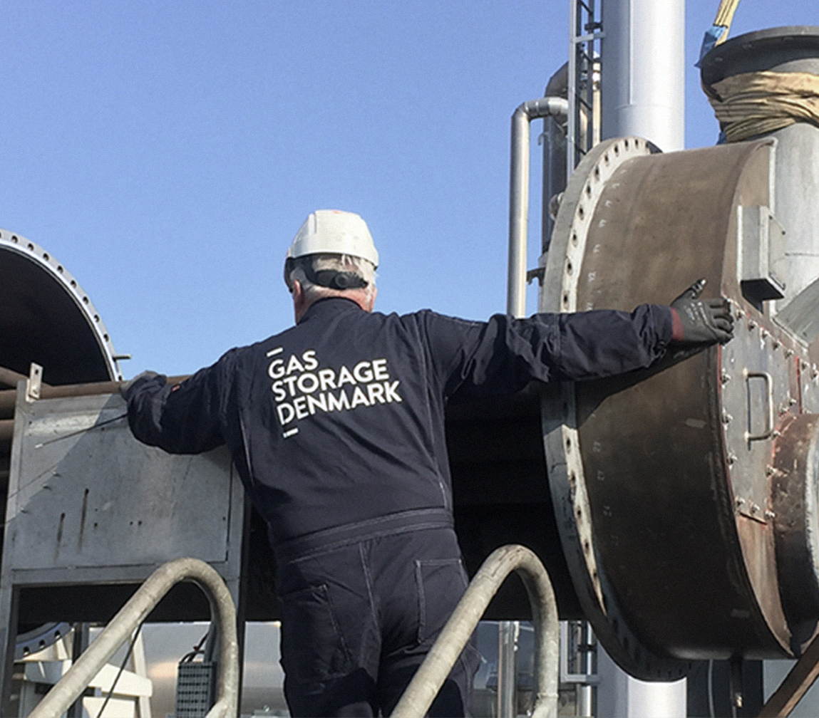
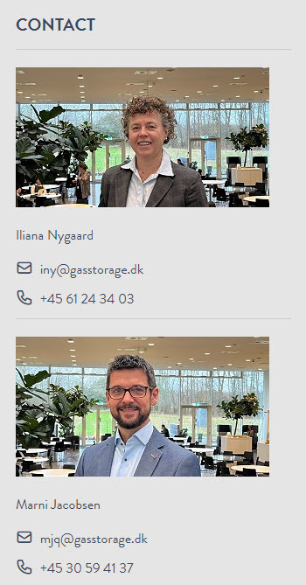
gas storage denmark
Marni Jacobsen

Slide 32

Danish Utility
Regulator
Current cases
Energinet, Shippers’ Forum
8 June, 2023
Peter Lyk-Jensen

Slide 33
Current Cases and Pipeline
Decisions:
Long and short term capacity quotas, Faxe and Ellund
    Approvals April 11th 2023
Other:
Congestion management at IPs
    New regulation 2022/2576 (“Enhancing solidarity …”): TSO must offer underutilised capacity on MA, DA and WD basis
    Energinet’s existing congestion mechanisms are in accordance with article14.7(c)
Ongoing:
Offshore tariff complaints 2011-2021
    Expect consultation on decisions
    2nd half of 2023
    Comparison to market practice ongoing
    Expect consultation to start end of June
Balancing model issues
    DUR is following the situation
    Ongoing dialogue with Energinet

Slide 34
Monitoring the Danish Wholesale Gas Market
Market Report 2022
Energinet, Shippers’ Forum
8 June, 2023
Frederik Nilausen Dam

Slide 35
The Danish Wholesale Gas Market 2022
Market Monitoring Report 2022 will be published 9 June 2023
The Danish Utility Regulator has obligations to:
  Monitor the Danish wholesale
  gas market
  Enforce REMIT
Focus on:
  Price developments
  Import and export
  Storage utilisation
  Market behavior
  Price signals and utilisation of Ellund missing due to data being delivered just before publication.
  Independent analysis on this topic expected Q3/Q4 2023

Slide 36
Production and Consumption
Annual production and consumption, 2015-2022
Offshore production
  Decreased by 3 pct. compared to 2021
Biomethane production
  Production increase to 0.57bcm in 2022
  Increased by 15 pct. compared to 2021
  31 pct. of consumption
Consumption
  DK consumption record low
  1.8bcm in 2022
Source: The Danish Utility Regulator based on data from the Danish Energy Agency

Slide 37
Import and Export
Import and export per country, 2022
Import
  Denmark was net importer in 2022 – but with few months of net export
  Increase in imports in 2022 – especially in Q4 due to Baltic Pipe
  72 pct. import from Germany
  28 pct. import from Norway
Export
  Due to Baltic Pipe, new export to Poland
    44 pct. export to Netherlands
    26 pct. export to Sweden
    30 pct. export to Poland
Source: The Danish Utility Regulator based on data from the Danish Energy Agency

Slide 38
Storage
Storage Utilisation, Injection, Withdrawal, 2022-2023
Storage capacity 2021: 9.9 TWh
  Average price in 2022:
  6.47 EUR/MWh (up 24 pct.)
  Average price in 2022: (170/120 product)
  5.48 EUR/MWh
High filling level during the year
  EU storage regulation
Status as of June 2023
  Storage sold out, high filling level
  Seasonal spread positive
Source: The Danish Utility Regulator based on data from Energi Data Service

Slide 39
Trading and Market
Traded Volume at ETF and GTF, 2018-2022
Total traded/delivered volume
  Exchange (ETF): 12 TWh
  Bilateral (GTF): 18 TWh
GTF is primary delivery point
  Baltic Pipe impact
  Share of volume:
    ETF: 40 pct.
    GTF: 60 pct.
Day-ahead and weekend products
→ 90 pct. of traded volume
Market concentration is moderate
  GTF is increasing
  DUR is monitoring development to ensure well functioning markets
Source: The Danish Utility Regulator based on data from Energinet

Slide 40
Trading and Market
Price Development for D-A in DK, NL, and DE, 2022
Spot prices at ETF record high
  30 August: 320.4 EUR/MWh
  Avg. price 2022: 125.1 EUR/MWh
Avg. price 12 times higher than in 2020
  High volatility in 2022
Avg. price in 2022
  Q1: 99.3 EUR/MWh (431 pct. ↑)
  Q2: 100.7 EUR/MWh (304 pct. ↑)
  Q3: 198.8 EUR/MWh (320 pct. ↑)
  Q4: 100.1 EUR/MWh (4 pct. ↑)
Status as of June 2023
  Price level has “normalised”
  TTF July 23: below 25 EUR/MWh
Source: The Danish Utility Regulator based on data from EEX

Slide 41



Focus areas 2023
REMIT obligations
Impact of Baltic Pipe
Price developments and supply of gas, especially due to the war in Ukraine
Ellund: Capacity utilisation,
gas flows vs. price signals
Utilisation of the Danish gas storages

Slide 42
Thank you.
If you have any questions, please raise a hand
Frederik Nilausen Dam
+45 4171 5375
fnda@forsyningstilsynet.dk

Slide 43
REMIT

Slide 44
Content
What is REMIT? What are the obligations of market participants? What is the role of the Danish Utility Regulator?

Slide 45

What is REMIT?
REMIT is Regulation (EU) No 1227/2011 on wholesale energy market integrity and transparency.
REMIT is a mechanism for reporting and preventing wholesale energy market abuse, in force since 28 December 2011.
Main objectives:
ensure that consumers and other market participants can have confidence in the integrity of electricity and gas markets,
that prices set on wholesale energy markets reflect a fair and competitive interplay between supply and demand, and
that no profits can be drawn from market abuse

Slide 46



What are the obligations of market participants?
Register with the national regulatory authority in the one EU country they have their primary activities.
Keep the company information in the register up-to-date
Report all wholesale transactions with gas and electricity to ACER through a Registered Reporting Mechanism
www.acer-remit.eu/ceremp

Slide 47

What are the obligations of market participants?
Disclose any insider information to the public
Disclosure has to be on an Insider Information Platform
Since 1. january 2022 own website is no longer accepted disclosure
www.acer-remit.eu/portal/list-inside-platforms
If market participants encounter something suspicious, they are always welcome to notify us – can also be done anonymously:
www.acer-remit.eu/np/str
Persons Professionally Arranging Transactions have the legal obligation to notify the regulatory authorities on possible REMIT breaches

Slide 48

What is the role of Danish Utility Regulator?
DUR operates the national register and receive data on all transactions from ACER
ACER and PPATs monitor the markets and inform DUR on potential REMIT breaches
DUR investigates potential REMIT breaches
Competence on enforcement split between DUR and State Prosecutor
  Administrative sanctions by DUR
  Criminal law sanctions by State Prosecutor
  ACER and/or DUR publish guidance on REMIT

Slide 49

Thank you for listening
And thank you for having the possibility to present this

Slide 51

Tariffs
Jeppe Danø, Energinet

Slide 52
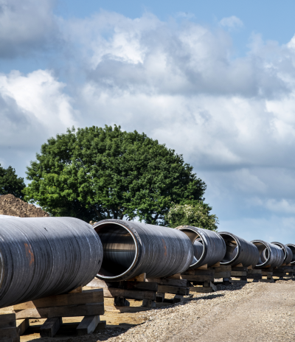
Content
Introductory remarks
Tariffs 2024
Development in transportation tariffs
Assumptions:
  Cost base
  Under coverage
  Capacity and flow

Slide 53
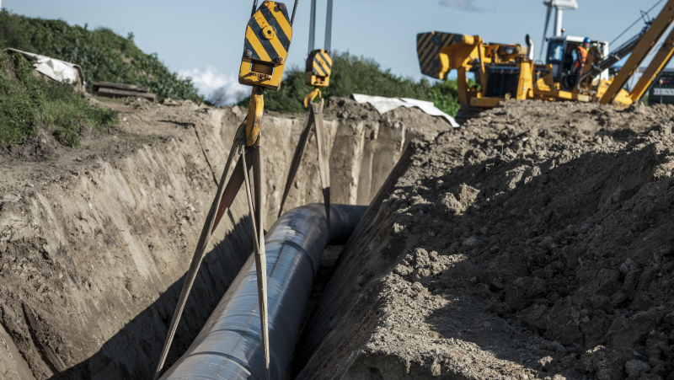
Introductory remarks
Tariff period for the calendar year 2024, due to last years change from gas year to calendar year.
Continued conditions:
100 per cent capacity tariff
Uniform tariff methodology
The emergency supply tariffs will be published in September.

Slide 54
Tariff effects 2024
(DKK/KWh/H/year)
+32%
  Transmission tariff 46,64 DKK/kWh/h/year
  Non-transmission tariff 11,72 DKK/kWh/h/year
  Total 58,36 DKK/kWh/h/year
58,36
50,19
44,11
Tariff 2022/2023
Under coverage
After under coverage
Depreciation
WACC inkl. tax
Cost base
Costs of process energy
Capacities
Tariff 2024

Slide 55
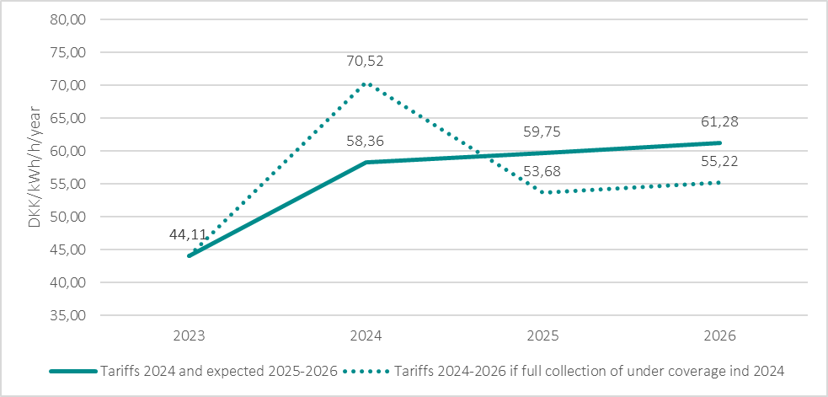
Development in Transportation tariffs
Full collection of the expected under coverage in 2024 would have caused transportation tariffs of 70,52 DKK/kWh/h/year.

Slide 56
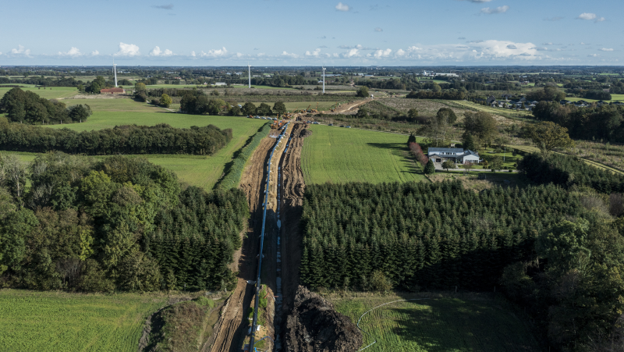
Assumptions

Slide 57
Cost BASE

Slide 58

Under coverage
Expected accumulated under coverage end of year 2023 of 586 mDKK.
In order to keep the tariffs as stable as possible, the under coverage will be collected during a three year period.
Main reasons for the under coverage:
Lower booked capacity than expected due to lower consumption
Higher depreciation related to reestablishment of assets
Changed tax regulation for assets and EU subsidy
Higher costs of balancing
Expected accumulated under coverage end of year 2023

Slide 59
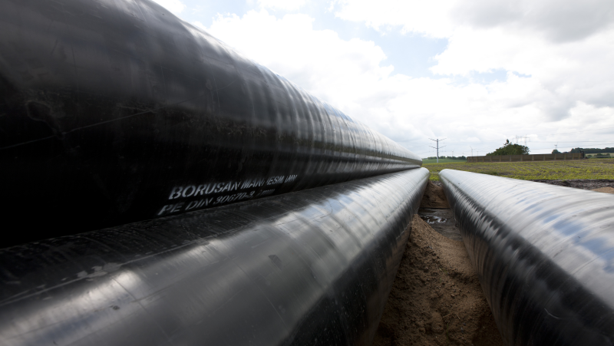
Capacity and FloW assumpTIONS
 | 2022/2023 | 2024 | Change
Capacity (kWh/h/year)
Exit JEZ | 3.847.673 | 3.185.670 | -17%
Exit Ellund | 100.000 | 370.000 | 270%
Exit Faxe | 11.752.854 | 11.652.969 | -1%
Exit Capacity | 15.700.527 | 15.208.639 | -3%
Entry Nybro | 1.025.000 | 2.678.667 | 161%
Entry Ellund | 2.842.282 | 1.539.450 | -46%
Entry RES | 1.002.222 | 1.051.555 | 5%
Entry EPII | 11.080.356 | 11.652.969 | 5%
Entry Capacity | 15.949.860 | 16.922.641 | 6%
Capacity total | 31.650.386 | 32.131.280 | 2%

Slide 60
Contact: jda@energinet.dk

Slide 61

Data and Balancing
Christian Rutherford, Energinet

Slide 62
Status on the new balancing model
The balancing model has gradually improved since Q4 2022, and the model now works as intended.
Balancing model as of 8th of June
Robustness of the model
Balancing model evaluation
Weekly stand-up meetings
The technical functions work as intended
When data errors occur, they are detected and corrected faster
The quality of data has been improved and data is incrementally getting better
Rescheduled to
1 September 2023, in agreement with Danish Utility Regulator
Approximately 5 weeks consultation starting beginning of July 2023
The weekly stand-up meetings have been discontinued since 30 May
Market meeting on balancing status will be held ultimo June 2023

Slide 63




Update on Balance Invoicing
The invoice module is currently being tested. We expect to start the invoice process for Q4 2022 in June 2023
Balance invoice timeline and process flow
Primo June
Ultimo June
July - November
December -
1
2
3
4
Invoice module undergoing last stage of tests
Starting invoicing beginning with October 2022
Catching up with invoicing up until October 2023
Initiating ordinary monthly invoice process
8th of June 2023

Slide 64
Status on Green Zone Flexibility
Fundamentally, the size of the green zone reflects the available flexibility in the transmission system and the integrity of the system must be considered when determining its size.
The green zone has in beginning been limited due to:
Operational issues with the Everdrup compressor station
Calibration of IT tools needed for the control center to properly operate
On February 14 Energinet implemented an operational bypass solution with Gaz-system which increased flexibility
Full flexibility will be reached when point 2 is resolved – expectation is within the coming months
Green zone lower than previously communicated
Flexibility (15 GWh)
Flexibility (25 GWh)
Flexibility (max. 40 GWh)
Yellow zone
Yellow zone
Yellow zone
Upper band(+x)
0
Green zone
Green zone
Green zone
Lower band (-x)
Yellow zone
Yellow zone
Yellow zone
October - January 2023
February 2023 - today
Steady state

Slide 65
Perspectives on the flexibility after 1 October 2022
Energinet agrees that the previous communication should have been more precise, and should have included a disclaimer, as the calculations were made well in advance of the commencement of the Baltic Pipe. However:
Full flexibility after October 2022 will in all scenarios be larger than January-September 2022 (max. 16 GW)
The new balancing model indirectly increases flexibility in the first part of the gas day.
BP flow | Green zone (avr.) | Smoothing (fixed) | Total flexibility
20 pct. | 35 GWh | 5 GWh | 40 GWh
50 pct. | 29 GWh | 5 GWh | 34 GWh
80 pct. | 21 GWh | 5 GWh | 26 GWh
100 pct. | 16 GWh | 5 GWh | 21 GWh
Start of gas day
End of of gas day
Indirecty added flexibility
Full green zone size for all gas day
Hourly flexibility need
Indirecty added flexibility
The figure illustrates that the nature of the fixed green zone value for the full gas day indirectly increases the flexibility in the first part of the gas day.

Slide 66
Neutralization of imbalance fees after go-live
Energinet has settled on principles that will guide the neutralization of imbalance fees in the period
1 October 2022 – 8 January 2023.
Background
Principles
Neutralization method
Data and IT challenges adversely affected the shipper's ability to properly balance during the start-up phase
Energinet has therefore, based on input from the market, put forward a series of principles that will guide neutralization
The neutralization is an add-on to the implemented No Punishment principle (NPP), which is applied both during and after the defined period
Individual assessment of all days in the period
8 January was chosen as the end date since the last known matching issues were resolved on this day
However, Energinet expects that there will be a few gas days after the 8 January that will also be neutralized
Neutralization will only apply to shippers with JEZ consumption
Shippers are not assessed individually
The imbalance price will be replaced by the European Gas Spot Index price (EGSI)
The EGSI-price is also used in the ordinary NPP settlement for causer allocation
Neutralization will be carried out in parallel with the ordinary balance invoicing

Slide 67
Contact: cru@energinet.dk

Slide 68

Capacity
Christian Rutherford, Energinet

Slide 69
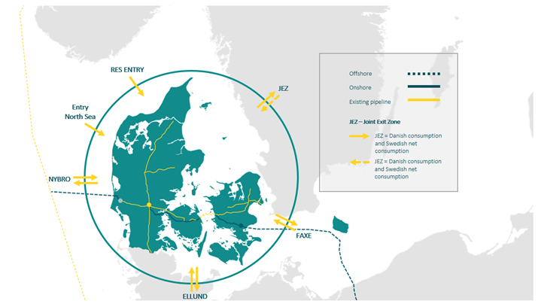
Annual capacity offer for coming gas year
Baltic Pipe and entry/exit points
Please note: annual tariff changing from gas year to calendar year from 24 January
North Sea entry
Total capacity: 13,400 MWh/h
Offer GY 23/24: 1,500 MWh/h
Offshore
Onshore
Existing pipeline
JEZ – Joint Exit Zone
Nybro entry
Total capacity: 8,600 MWh/h
Offer GY 23/24: 8,600 MWh/h
JEZ = Danish consumption
and Swedish net
consumption
JEZ = Danish consumption
and Swedish net
Consumption – reverse flow
Ellund entry
Total capacity: 7,400 MWh/h
Offer GY 23/24: 5,600 MWh/h
Faxe entry
Total capacity: 3,900 MWh/h
Offer GY 23/24: GWh/h 3,500 MWh/h
Ellund exit
Total capacity: 7,400 MWh/h
Offer GY 23/24: 6,700 MWh/h
Faxe exit
Total capacity: 13,400 MWh/h
Offer GY 23/24: 1,500 MWh/h
For more information, please go to: Calculated capacities in the Danish gas transmission system | Energinet

Slide 70

Market consultation on Congestion Management Procedures (CMP) for Faxe
Energinet proposes:
A continuation of already implemented CMP tools in DK:
  Oversubscription and buy-back
  Surrender of contracted capacity
  Use-it-or-lose-it for long-term capacity.
No comments received in consultation.
If approved by Danish Utility Regulator – means no changes to BfG.

Slide 71
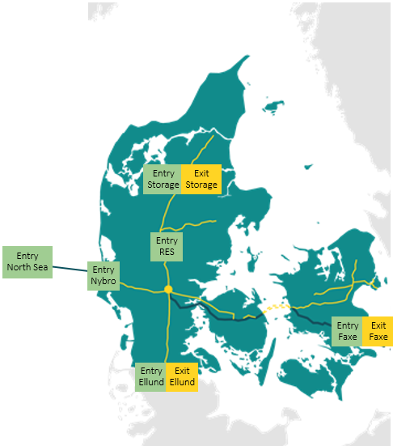
Incremental capacity process
Starts beginning of July
Shippers have the opportunity to indicate their future potential need for capacity
In case the aggregated user demands exceeds capacity in a point, the incremental capacity process gives users the opportunity to enter into contracts for such extra capacity. Thereby, steering Energinet to develop the network further.
After the annual auction on 3 July 2023, Energinet will forward demand assessment questionnaires for all capacity points in the Danish system – to be submitted latest 8 weeks after.
Important to also indicate interest in adjacent systems, when relevant!

Slide 72
Ellund capacity
LNG implementation in Germany causes Gasunie to reduce both north- and southbound capacity at Ellund
Northbound capacity reduction is caused by uncertainty of the wobbe-index level from LNG cargos which can exceed the allowed threshold in Denmark (but not in Germany).
Southbound capacity reduction is caused by a bottleneck in Gasunie’s system.
We are in a continuous dialogue with Gasunie
If you (the market) are dissatisfied with the German capacity level, we encourage you to let Gasunie know – also be aware of the German Net Development Plan process (deadline 13 June)

Slide 73
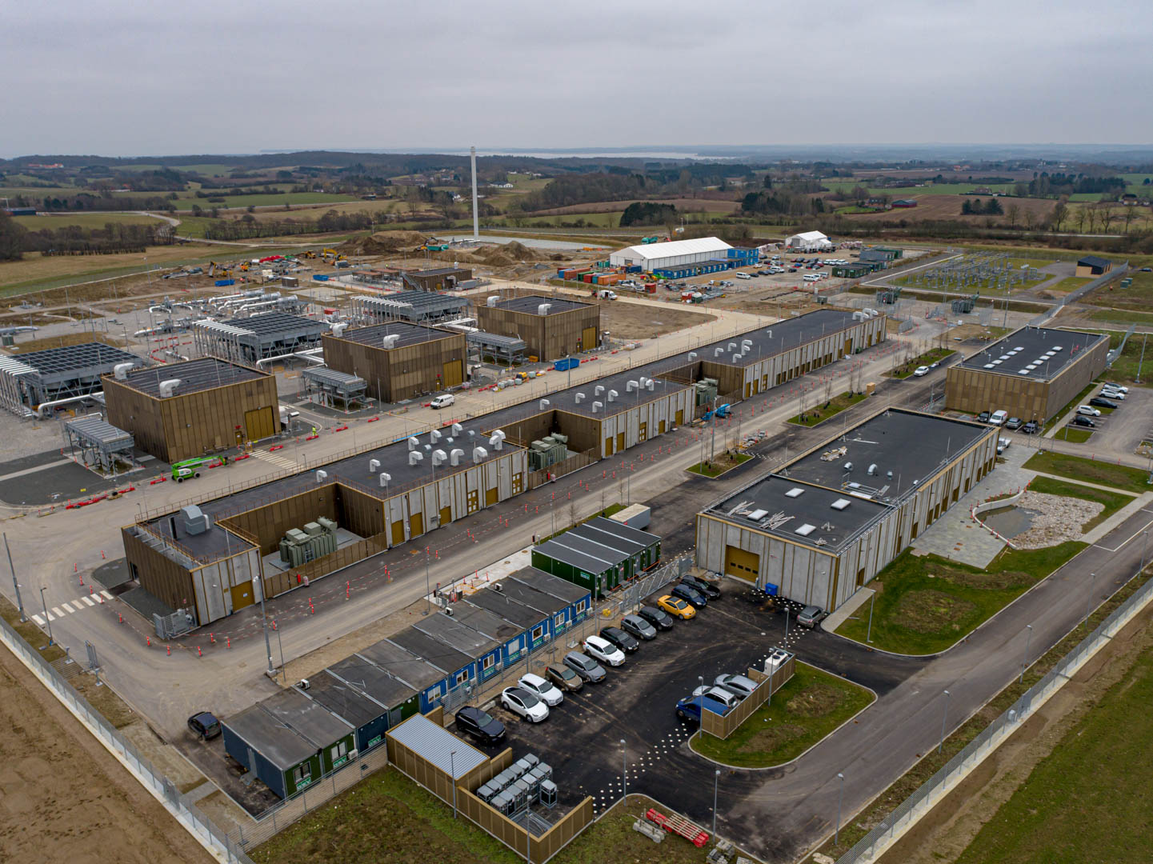
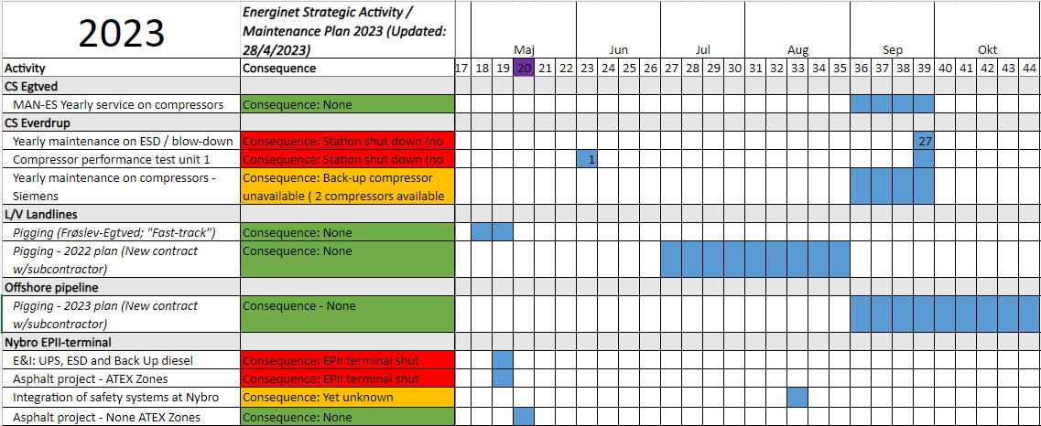
Maintenance
Maintenance and final tests dominates the activities on Nybro Europipe II terminal and Compressor station Everdrup
Most activities do not affect the capacity
Next planned activity affecting capacity is CS Everdrup (Poland) end of September (3 days)
Other planed activities in 2023 has limited or no impact on capacity
UMM is issued ahead of planned activities affecting capacity
For updated information please visit:
strategic-activity-plan-gas-system-2023.xlsx (live.com)

Slide 74
Contact: cru@energinet.dk

Slide 75

Final Remarks
Clement Johan Ulrichsen, Energinet

Slide 76

Next Shippers forum: 14 Sep. 2023
Will be located off-site
The timeslot is not fixed – be prepared for a possible morning meeting
More information will be given latest 1 of August.

