Slide 1
Appendix 1.C Robustness requirements for electricity generation facilities
Network Code on Requirements for Grid Connection Applicable to all Generators (RfG)
Lars Højbjerg Nielsen
This is a translation. In case of inconsistencies, the Danish version applies.

Slide 2
Future robustness requirements
Requirements for fault-ride-through properties
Requirements for t_{clear} and U_{ret} for generation facilities connected to the distribution grid are described below:
t_{clear} = 250 ms applies to all generation facilities of types B and C as well as type D
U_{ret} = 0.3 p.u. applies to all synchronous generation facilities of types B and C as well as type D
U_{ret} = 0.15 p.u. applies to all asynchronous generation facilities of types B and C as well as type D
Requirements for t_{clear} and U_{ret} for generation facilities connected to the transmission grid are described below:
t_{clear} = 150 ms applies to for all type D generation facilities connected to the transmission grid
U_{ret} = 0.0 p.u. applies to all type D generation facilities connected to the transmission grid
The FRT requirements stated apply to both symmetrical and asymmetrical fault types. The positive voltage sequence component must be considered in any voltage evaluation.

Slide 3
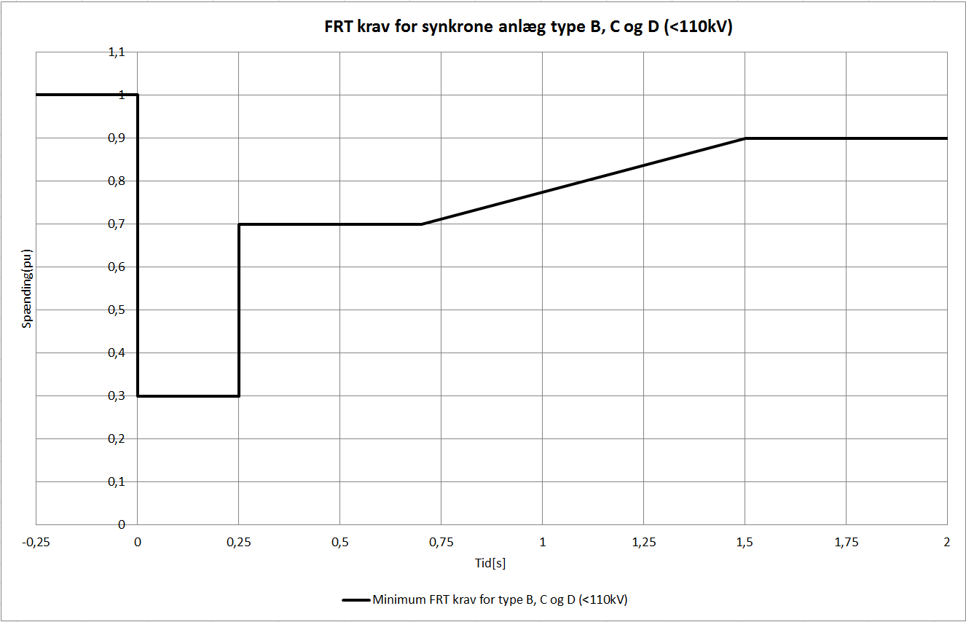
FRT requirements for synchronous (SGpm) facilities connected to the distribution grid in DK1 (CE) and DK2 (N)
Types B, C and D (< 110 kV) facilities
Voltage parameters (pu) |  | Time parameters [seconds]
U_{ret}: | 0.3 | t_{clear}: | 0.25
U_{clear}: | 0.7 | t_{rec1}: | 0.25
U_{rec1}: | 0.7 | t_{rec2}: | 0.70
U_{rec2}: | 0.9 | t_{rec3}: | 1.5

Slide 4
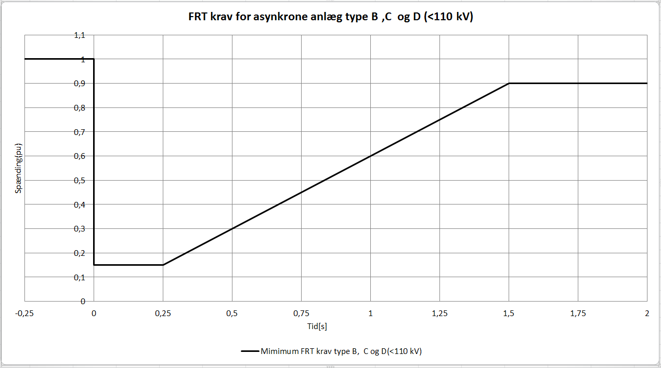
FRT requirements for asynchronous (PPM) facilities connected to the distribution grid in DK1 (CE) and DK2 (N)
Types B, C and D (< 110 kV) facilities
Voltage parameters (pu) |  | Time parameters [seconds]
U_{ret}: | 0.15 | t_{clear}: | 0.25
U_{clear}: | 0.15 | t_{rec1}: | 0.25
U_{rec1}: | 0.15 | t_{rec2}: | 0.25
U_{rec2}: | 0.9 | t_{rec3}: | 1.5

Slide 5
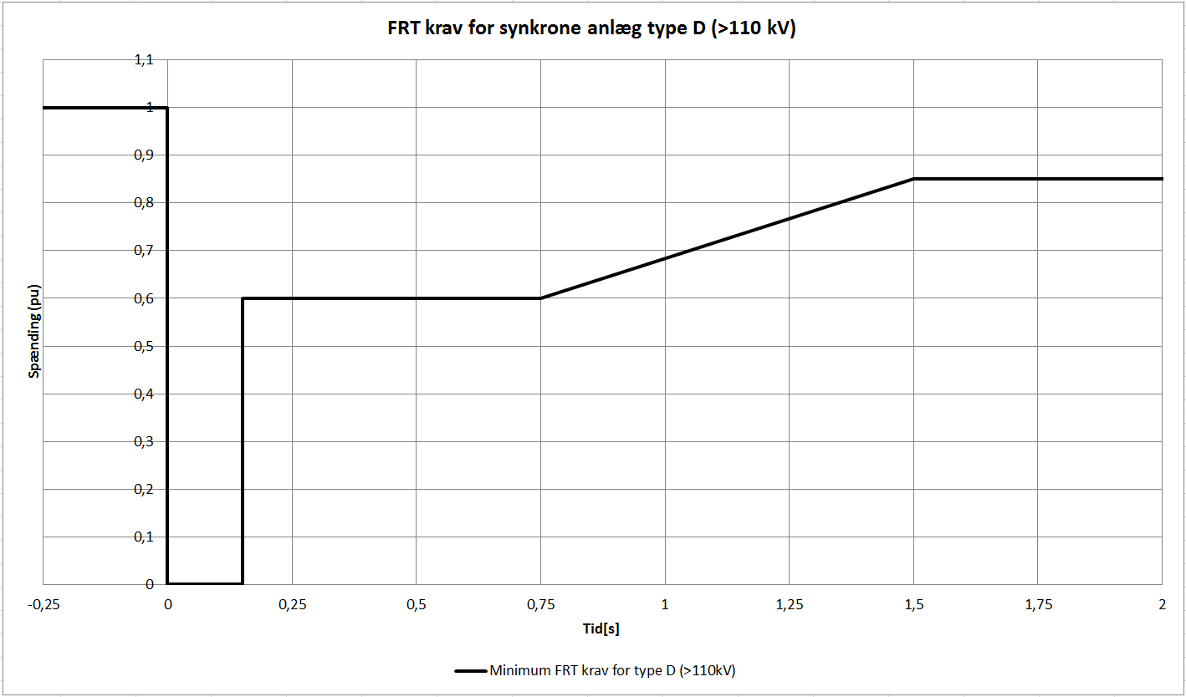
FRT requirements for synchronous (SGpm) facilities connected to the transmission grid in DK1 (CE)
Type D facilities connected > 110 kV
Voltage parameters (pu) |  | Time parameters [seconds]
U_{ret}: | 0 | t_{clear}: | 0.15
U_{clear}: | 0.6 | t_{rec1}: | 0.15
U_{rec1}: | 0.6 | t_{rec2}: | 0.75
U_{rec2}: | 0.85 | t_{rec3}: | 1.5

Slide 6
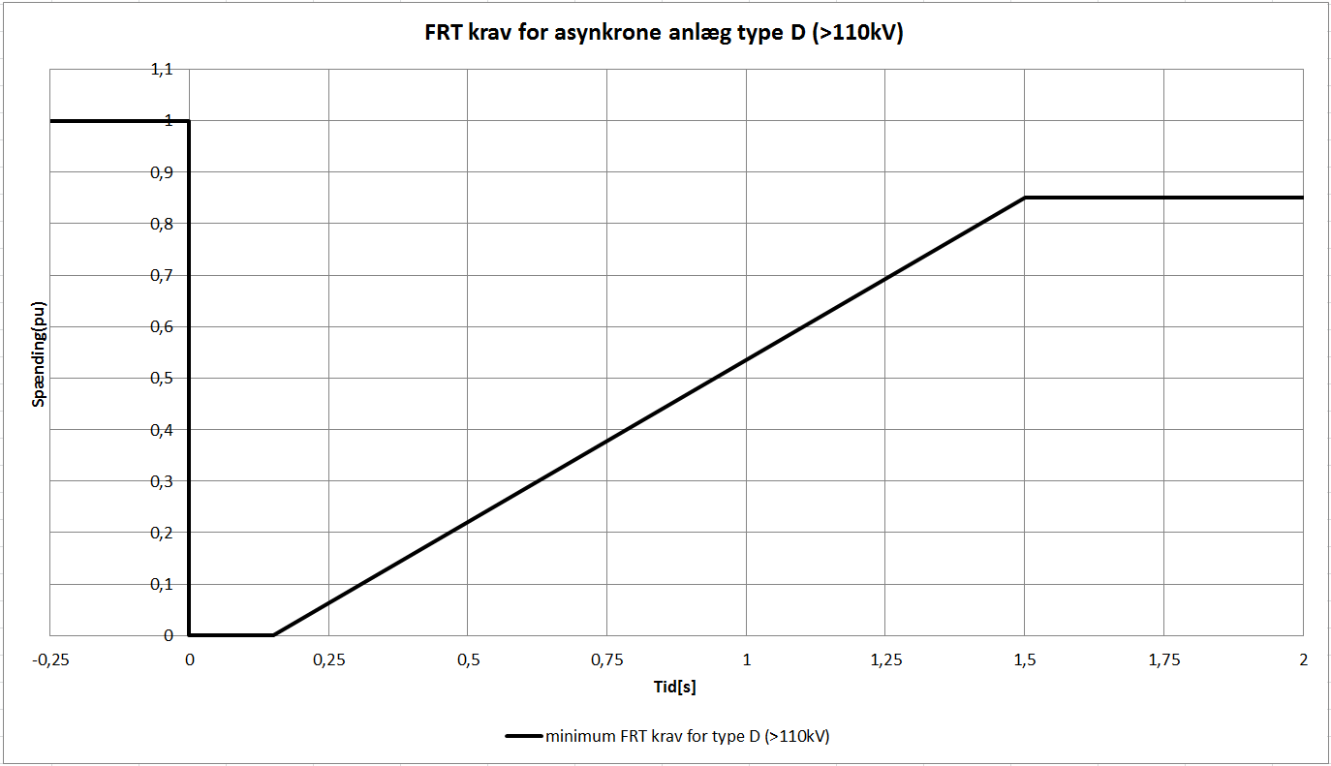
FRT requirements for asynchronous (PPM) facilities connected to the transmission grid in DK1 (CE)
Type D facilities connected > 110 kV
Voltage parameters (pu) |  | Time parameters [seconds]
U_{ret}: | 0 | t_{clear}: | 0.15
U_{clear}: | 0 | t_{rec1}: | 0.15
U_{rec1}: | 0 | t_{rec2}: | 0.15
U_{rec2}: | 0.85 | t_{rec3}: | 1.5

Slide 7
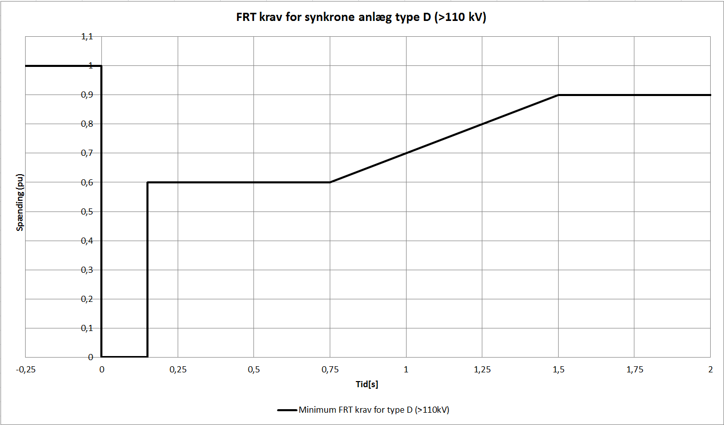
FRT requirements for synchronous (SGpm) facilities connected to the transmission grid in DK2 (N)
Type D facilities connected > 110 kV
Voltage parameters (pu) |  | Time parameters [seconds]
U_{ret}: | 0 | t_{clear}: | 0.15
U_{clear}: | 0.6 | t_{rec1}: | 0.15
U_{rec1}: | 0.6 | t_{rec2}: | 0.75
U_{rec2}: | 0.9 | t_{rec3}: | 1.5

Slide 8
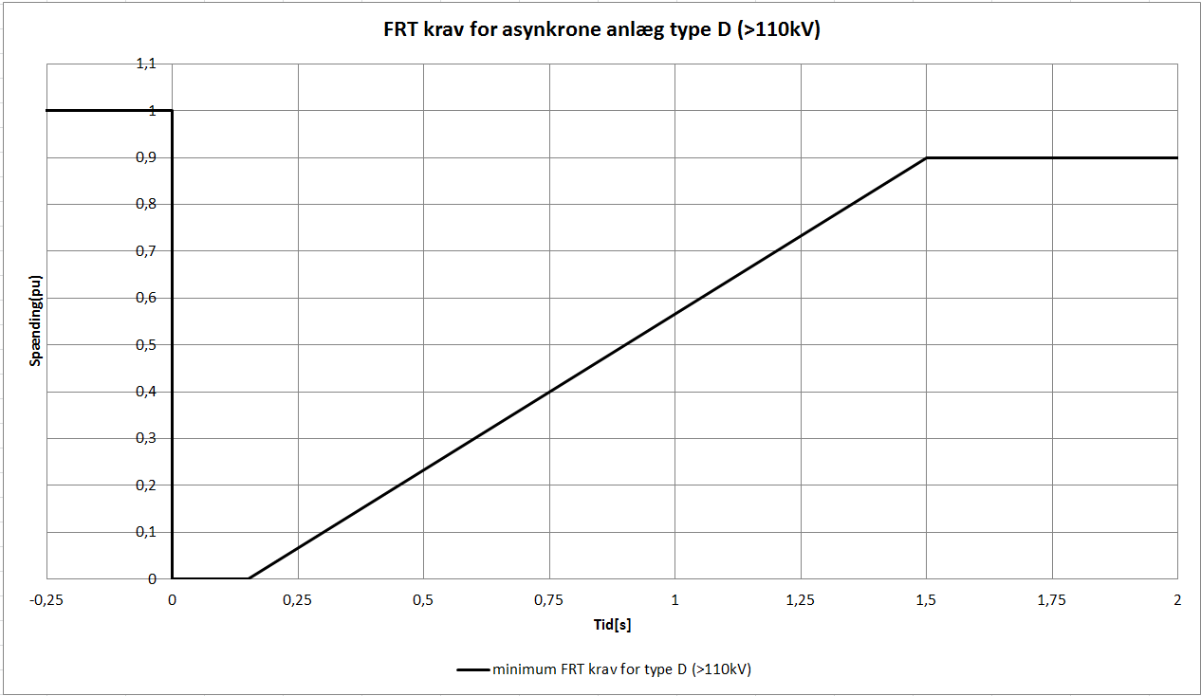
FRT requirements for asynchronous (PPM) facilities connected to the transmission grid in DK2 (N)
Type D facilities connected > 110kV
Voltage parameters (pu) |  | Time parameters [seconds]
U_{ret}: | 0 | t_{clear}: | 0.15
U_{clear}: | 0 | t_{rec1}: | 0.15
U_{rec1}: | 0 | t_{rec2}: | 0.15
U_{rec2}: | 0.9 | t_{rec3}: | 1.5

