Slide 1
Shippers’ Forum
9 March 2023

Slide 2
Safety Guide
Emergency Exits
Defibrillator
Gathering Point

Slide 3
PROGRAMME
13:00 Welcome – Clement Johan Ulrichsen, Energinet
13:05 Danish Energy Agency – Jane Glindvad Kristensen, Danish Energy Agency
13:25 Security of Supply – Birgitte Troelsen, Energinet
13:35 Gas Storage Denmark – Iliana Nygaard, Gas Storage Denmark
13:55 BREAK
14:25 Current Cases and Pipeline – Peter Lyk-Jensen, Danish Utility Regulator
14:40 Revenue cap regulation on Gas-TO – Tomas Skov Lauridsen, Danish Utility Regulator
15:00 Capacity – Lasse Ellebæk Krogh, Energinet
15:20 Balancing – Christian Rutherford, Energinet
15:40 Final Remarks – Clement Johan Ulrichsen, Energinet

Slide 4

Welcome
Clement Johan Ulrichsen, Energinet

Slide 5









Developments in the gas market
19 Dec
14 Feb
EU regulation on coordination of gas purchases passed
Expanded green zone in balancing model
16 March?
EU proposal for electricity market reform
1 Dec
22 Dec
1 Feb
1 March
Trilogue negotiations on the EU's gas and hydrogen package expected soon
ETF gas price: 147 €/MWh
EU regulation on market correction mechanism passed
Storage filling target
45% < DK 85%
ETF gas price:
49 €/MWh
15 Feb
The EU market correction mechanism has entered into force

Slide 6
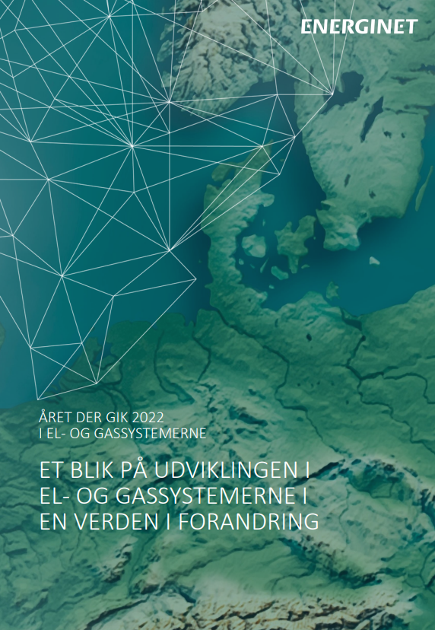

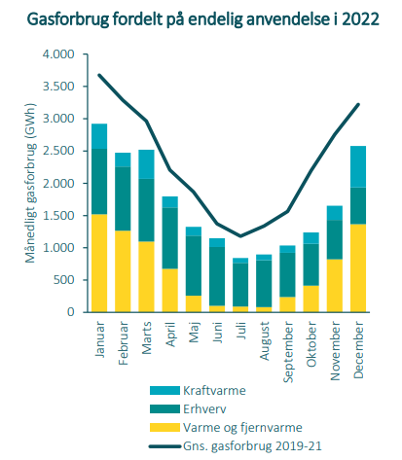
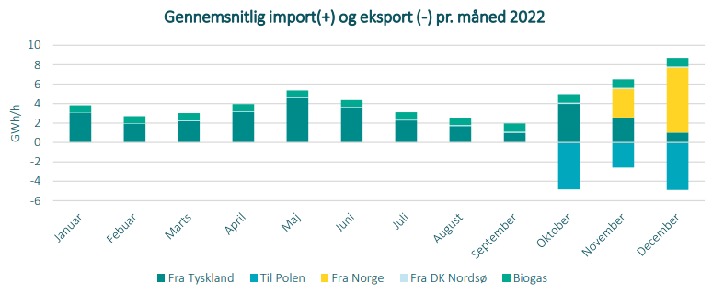
New Energinet publications
Year 2022 in Power- and Gas systems
‘Gasforsyningssikkerhed 2022’
Denmark has become a gas transit country due to Baltic pipe
Danish gas consumption has fallen by 25 % in 2022 compared with the average for 2019-2021
Gas consumption divided between final use in 2022
Average import (+) and export (-) per month 2022
Monthly gas consumption (GWh)
Heat and power plant
From Germany
To Poland
From Norway
From DK North Sea
Industry
Biogas
Heat and district heating
Avg. gas consumption 2019-21

Slide 7
Contact: cju@energinet.dk

Slide 8
Status on Security of Supply
9th March 2023
Head of Division, Jane Glindvad Kristensen

Slide 9
General status on supply
Energy systems are connected and affect each other

Slide 10
Supply situation
THIS WINTER (22/23)
NEXT WINTER (23/24)
GAS
Expected stable.
Volatile, high prices. Reduced gas from Russia. Increased LNG. Reduced use.
Challeging.
Reduced possiblities for storage filling.
ELEC.
Expected stable.
Volatile, high prices. Low production. Slightly reduced consumption.
Challeging.
Low production in Europe.
OIL
Stable supply.
High prices.
Expected stable.
Focus on consequences of EU sanctions.
HEAT & BIOMASS
Stable supply.
Higher prices.
Stable supply.
Notes:
Opmærksomheds-punkter:
EL:
Forbrug
Vandkraft i Norge
A-kraft i Frankrig, Sverige og Finland
Elforbindelser i Norge
”Ny” kapacitet i nabolande
GAS:
Forbrug
Gasmarkedet
Baltic Pipe
Gaslagre
OLIE:
Diesel
Konverteringer fra gas til olie
VARME OG BIOMASSE:
Forbrug
Biomasseleverancer (indv.)

Slide 11
Gas Supply
Status and coming months

Slide 12
Stable gas supply
Danish gas storage is just about 75% full
34% bio gas in the Danish gas system in 2022
Gas field Tyra reopens in winter 23/24
Prices has been high and varies a lot. Currently moderate.
Ørsted has contracted 8 TWh and Andel 2.6 TWh Norwegian gas via Baltic Pipe
Less Russian gas, but much more LNG in Europe
Notes:
8 TWh norsk gas hos Ørsted svarer til ca. 23 pct. af det forventede samlede danske forbrug fra januar 2023 – april 2024, hvor kontrakten løber
2,6 TWh norsk gas hos Andel svarer til ca. 10 pct. af det forventede samlede danske forbrug fra januar 2023 – december 2023, hvor kontrakten løber
Der var over 34% biogas i systemet i 2022
Prisudviklingen i efteråret 2022 og start 2023 har været mere positiv end forventet
For at opsummere: Gasforsyningen er stabil, og vi forventer ikke at afbryde nogen af de ikke-beskyttede gaskunder i år – men for næste år kan vi ikke give garantier, og prisen kan blive meget høj.

Slide 13
Forward market for gas
Current situation of expectations in the market
The market does currently not expect significant increase in prices the coming months and years.
Notes:
Omregning:
50 Euro/MWh
= 367 DKK/MWh
= 4,53 DKK/M3

Slide 14
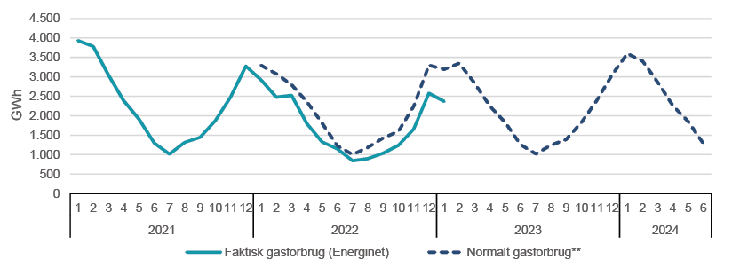
Gas savings
Reduction in gas consumption*
Last 12 months:
January + February 2023:
21 pct.
26 pct.
Note: Pipeline gas, being natural gas + upgraded bio gas
Notes:
Sidste 12 måneder t.o.m. januar 2023: 21 pct.
Januar 2026: 26 pct. ift. normalen. Samme resultat for februar.
Generelt er gasforbruget reduceret i EU
Det er rigtig positivt at forbruget af gas er faldet – det stiller os rigtig godt ift. at komme gennem vinteren, også når det kommer til elforsyning.
Noget af reduktionen skyldes, at vi har haft en lunt efterår. Derudover har mange at de mest gasforbrugende virksomheder omstillet til olie, hvilket bringer mig videre til næste slide.

Slide 15
”Main scenario” for gas supply
Notes:
Opdateret

Slide 16
”Energy savings-scenario” for gas supply
Notes:
Den indregnede reduktion er 21 % - tilsvarende de seneste 12 måneders gennemsnitlige reduktion

Slide 17
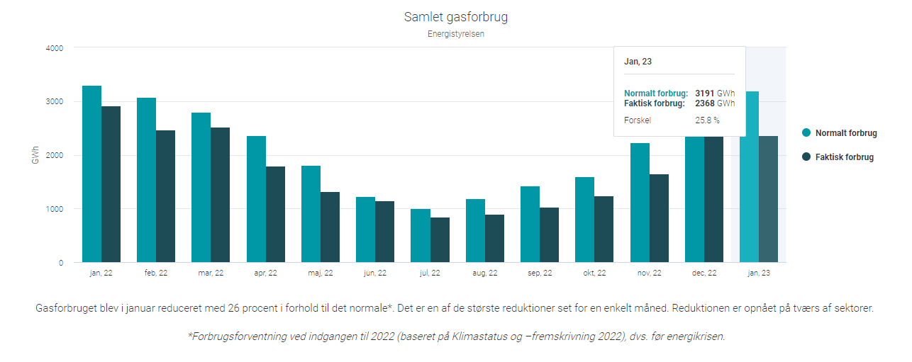
New DEA supply website updated monthly

Slide 18
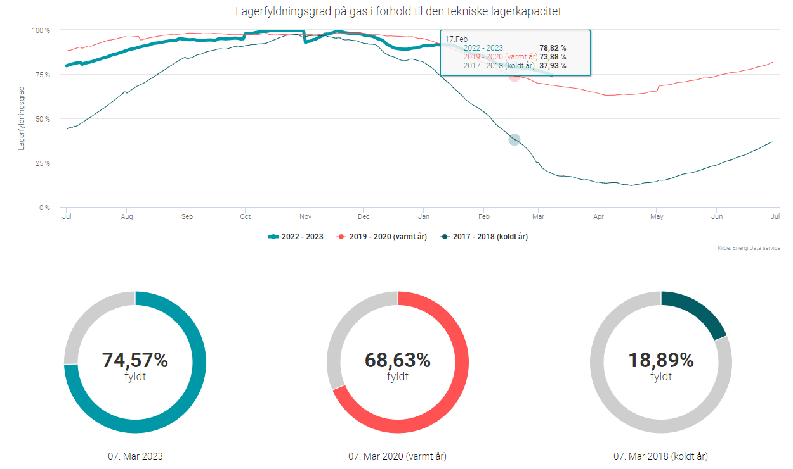
New DEA website, part 2

Slide 19
EU perspective
Status

Slide 20
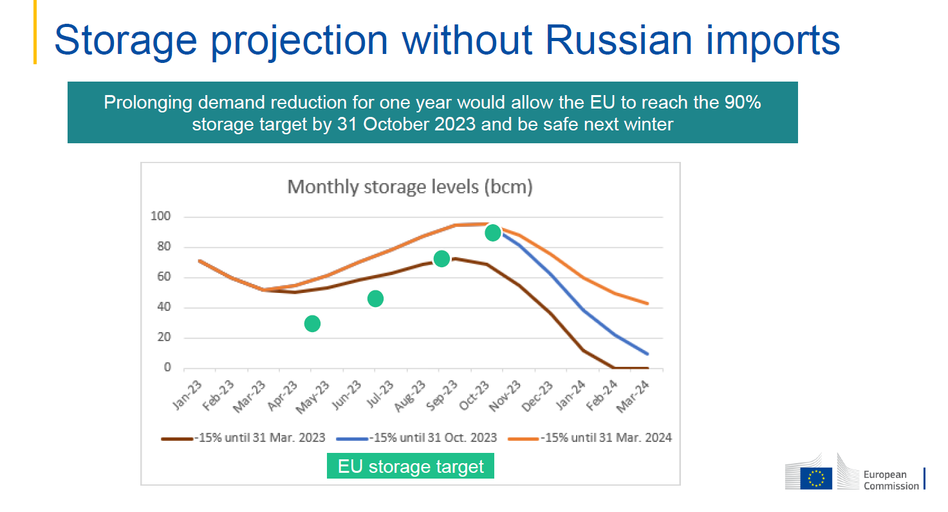
EU Commission likely to extent reduction regulation

Slide 21
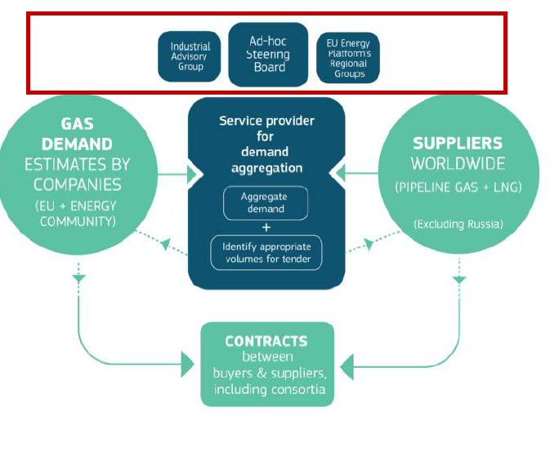
EU ENERGY PLATFORM
Notes:
EU ENERGY PLATFORM
Blev etableret i foråret 2022 for at sikre forsyning af gas.
Organiseret med en styringsgruppe med repræsentanter fra alle lande under ledelse af Vice-præsident Maroš Šefčovič
Styringsgruppen foretaget overordnet koordinering og rækker ud til trejdelande som kunne være interesseret i at sælge gas til EU (Energi diplomati)
Rådgivningsgruppe for industri, som giver råd i forhold til fælles indkøb af gas
Regional grupper, som behandler spørgsmål om særligt infrastruktur mv.
I december 2022 vedtog energiministerne en forordningen som giver det juridiske framework, herunder:
En serviceleverandør som skal stå for efterspørgselaggregering
Og indhente bud fra leverandører i verden af gas på fælles udbud af gas
→ Platformen skal via udbud bringe køber og sælger sammen.
Køber og sælger indgår her efter kontrakten.

Slide 22
Joint purchasing of gas across EU
The regulation of solidarity, coordination of gas purchases, exchanges of gas and reliable price benchmarks set a legal framework for joint purchasing of gas and holds the following items:
Transparency and information exchange on tender to purchase gas with a volume above 5 TWh/year
Demand aggregation and joint purchasing trough a service provider
Participating in demand aggregation and joint puchasing shall be open and transparent for all natural gas undertakings and undertakings consuming gas
Mandatory use of the service provider with volume of 15 % of the total volume to meet the filling targets.
Gas Purchasing Consortium
Notes:
EU kommissionen med Energiplatformen og i samarbejdet med medlemslandene været i gang med at implementere forordningen.
Forordningen indeholder følgende elementer:
Krav om øget gennemsigtighed om indgåelse af gaskontrakter på over 5 TWh/år:
KOM skal underrettes om disse kontrakter seks uger før indgåelse.
KOM vil også kunne rette henvendelse til forsyningsselskaber eller den gasforbrugende virksomhed, hvis KOM vurderer det har negativ indvirkning på marked, forsyningssikkerhed eller energisolidariteten.
Demand aggregation and joint purchasing
Efterspørgselsaggregering og fælles indkøb sker via en serviceleverandør.
KOM har valgt Prisma som serviceleverandør
Prisma stiller en platform til rådighed – kaldet AggregateEU
På platformen kan udbyder af gas (sælgere) og køber i form af gashandler, gasleverandører og gasforbrugende virksomheder kan melde indkøb ind på platformen. Alle kan deltage.
Prisma foretager et fælles udbud med afsæt i efterspørgselsaggregeringen.
Herefter informerer Prisma køberne om de indkomne bud.
Køberne indgår med afsæt i buddene selv kontrakter med sælgerne af gas.
3. Medlemsstater med lager skal fylde kræve af forsyningsselskaber eller gasforbrugende virksomheder at de samle indkøb på op til 15 pct af fyldningskravet.
Energistyrelsen vil i den forbindelse gerne høre fra interesserede, som vil lægge konkrete mængder af gas ind på platformen til fælles indkøb.
Det er frivilligt for virksomhederne om de vil indkøbe gas efter de har modtaget bud fra potentielle sælger.
4. Forordningen indeholder mulighed for at etablere et Gasindkøbsconsortium. KOM har dog efter nærmere dialog med branchen valgt en anden tilgang med to modeller:
Central buyer modellen
Agent on-behalf modellen

Slide 23
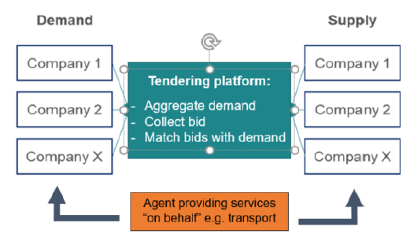
Company Cooperation
Central buyer model
Agent on-behalf model
Notes:
COM works with two model for company cooperation instead of a gas purchsing consortium
Central buyer model
one gas company (likely a mid-streamer) signs individual contracts with other buyers (likely smaller gas companies and gas consuming companies)
Central buyer signs a contract with supplier(s) for the demand aggregated by its group of buyers
Each gas company and industrial consumer would sign a contract with a Central Buyer.
Engagement of several mid-streamers as Central Buyers would introduce competition between them leading to lower costs for buyers.
Agent on-behalf model
a company provides shipping, balancing or other services to those gas companies and gas consumers willing to purchase gas but seeking help to secure these services themselves.
The agent on-behalf can be a member of a group of companies aggregating demand and providing such services to the other members of that group, or an independent company providing such services to any other buyer that requests it.
In both cases, buyers would negotiate and sign contracts bilaterally with the supplier(s).

Slide 24
NEXT STEP
The Commission with Prisma held a workshop on 7th March, where the AggregateEU platform presented.
In March and start April companies can register on platform and put the first volume to demand aggregation on the platform.
First tender will be held mid-April 2023
The Danish Energy Agency encourge Danish companies to take part in demand aggregation and joint purchasing via AggregateEU and Prisma.
Notes:
Målet med indkøbsplatformen er følgende:
Koordinering af indkøb af gas på verdensmarkedet, så EU virksomheder ikke overbyder hinanden.
Via udbud af fælles mængde af gas at gøre EU konkurrencedygtigt og skabe billigere priser
Sikre forsyningssikkerhed ikke bare mens markedet er funktionelt, men også i tilfælde af man ser en situation som i august 2022 med høje priser.
At give et redskab til at skaffe billigere gas i den kommende lagerfyldningssæson.
Energistyrelsen opfordrer danske virksomheder til at deltage i fælles indkøb.
Vi vil meget gerne kende mængder som danske virksomheder må melde ind på platformen, så vi sikre vi bidrage med de obligatoriske mængder.
Første udbud er i april 2023, herefter vil der blive afholdt månedlige udbud via Prismas platform.

Slide 27

Security of supply
Birgitte Troelsen, Energinet

Slide 28
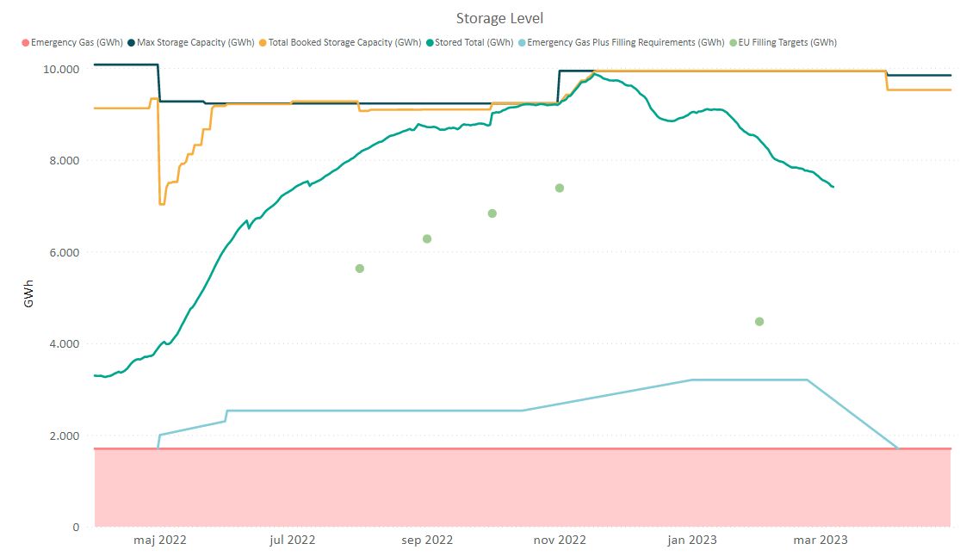
Security of supply
High inventory gas level for the season 75%
100% filled by November 17
EU filling target of 45% fulfilled
February 1

Slide 29
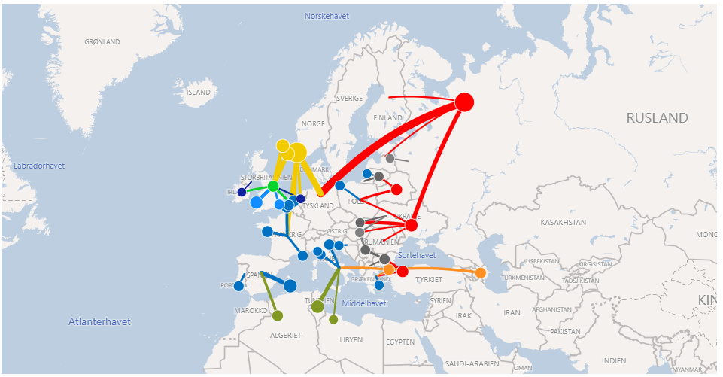
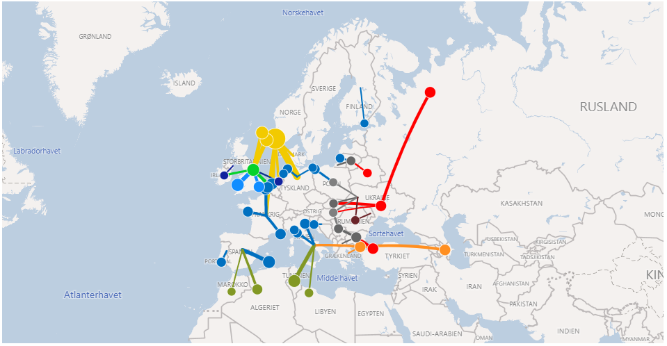
Physical gas flow to Europe
February 2022
February 2023
https://gasdashboard.entsog.eu/#map-flows

Slide 30
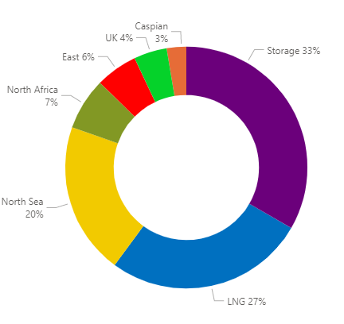
Supply to EU february 2022 and 2023
EU supply Feb 2023: 369 TWh
Storages: 33% (121 TWh)
LNG: 27% (100 TWh)
North Sea: 20% (74 TWh)
Other: 20% (74 TWh)
Feb 2023
EU supply Feb 2022: 399 TWh
Storages: 24% (96 TWh)
East: 22% (88 TWh)
LNG: 22% (88TWh)
North Sea: 20% (80 TWh)
Other: 12% (47 TWh)

Slide 31
EU gas storage inventory level
1.3.2023: More than dobble the inventory level compared to 1.3.2022

Slide 32
Contact: btr@energinet.dk

Slide 33
Shipper’S forum
9 MARCH 2023

Slide 34
Agenda
  CAPACITY OVERVIEW
  CUSTOMER PORTAL - NEW FEATURES
  VARIABLE INJECTION 1 APRIL
  E-WORLD 2023
  Q&A

Slide 35
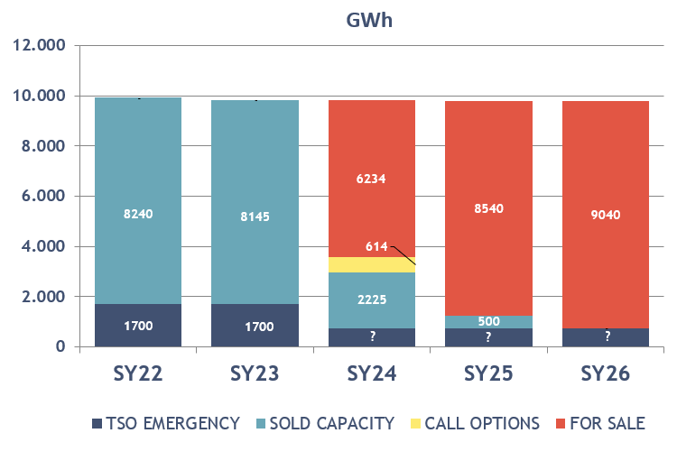
Capacity overview
2023 - SOLD OUT
2024+ available for sale
Pricing:
120/60: 4.0 €/MWh/year
170/85: 3.5 €/MWh/year
170/170: 3.0 €/MWh/year
Additional flex:
Injection: 750 €/MW/year
Withdrawal: 2,100 €/MW/year

Slide 36

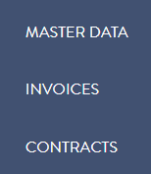
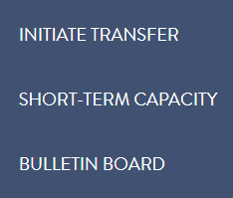
new features ● CUSTOMER PORTAL
Relations, Master data and Contracts overview
Nomination to storage
Storage data and Invoices overview
Initiate transfer available soon
Book short-term capacity available soon
Bulletin board available soon
https://customerweb.gasstorage.dk/home
USERSPECIFIC VIEW
View/access is depending on the user’s authorization
AUTHORIZATION TYPES
Storage Customer
Nomination
Contract Viewer
User Administrator

Slide 37

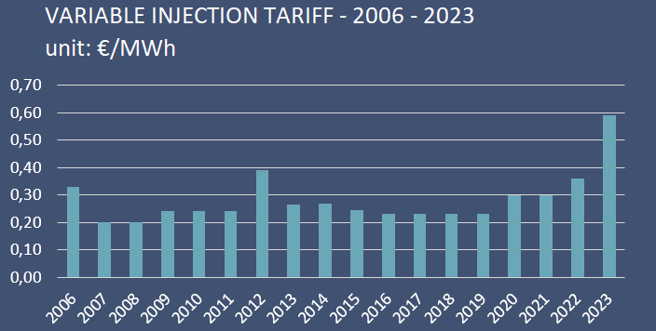
  VARIABLE INJECTION ● FLAT RATE → 1 APRIL
starting per 1 APRIL 2023 the variable injection tariff will change 0.36 → 0.59 €/MWh
https://gasstorage.dk/news/2023/02/22/change-in-the-variable-injection-tariff/
PRICE DRIVES
THE STORAGE FACILITIES USE
  POWER FOR INJECTION
  GAS FOR WITHDRAWAL
RISING POWER AND GAS PRICE

Slide 38
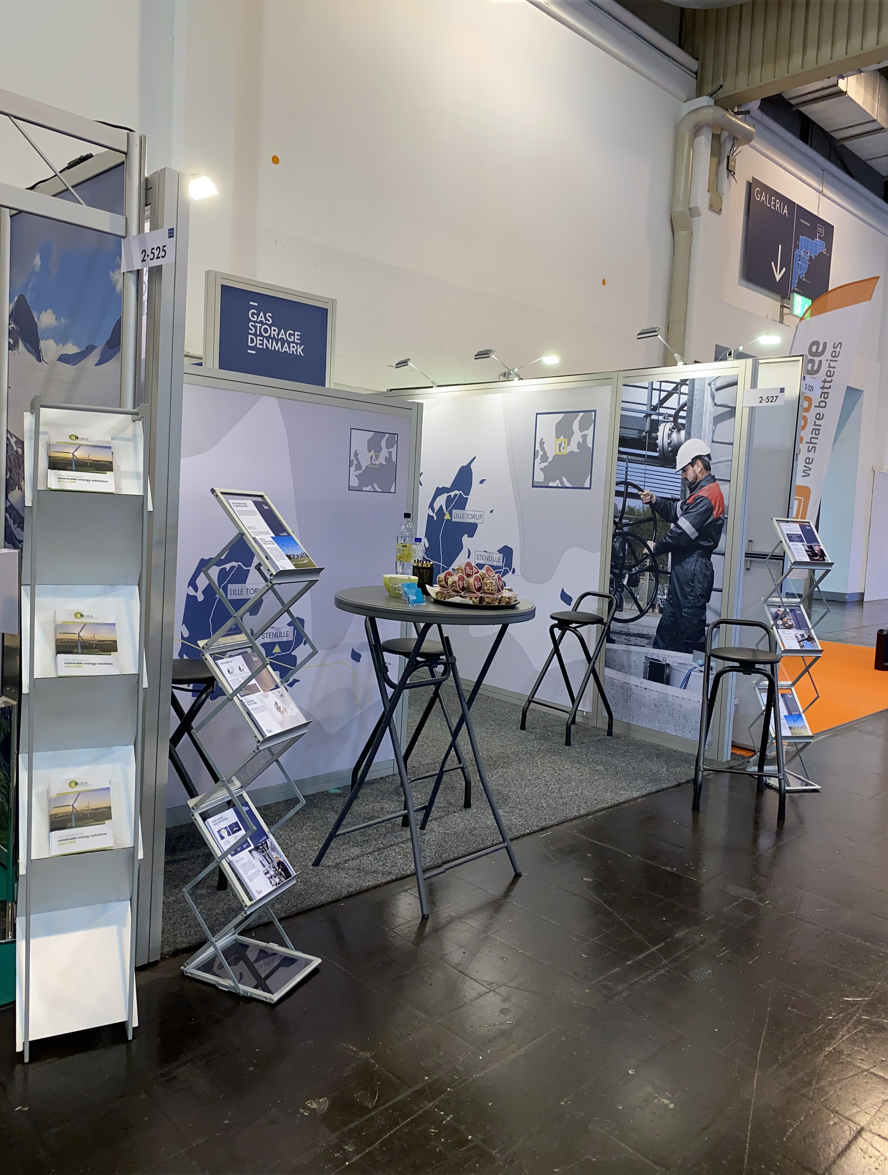

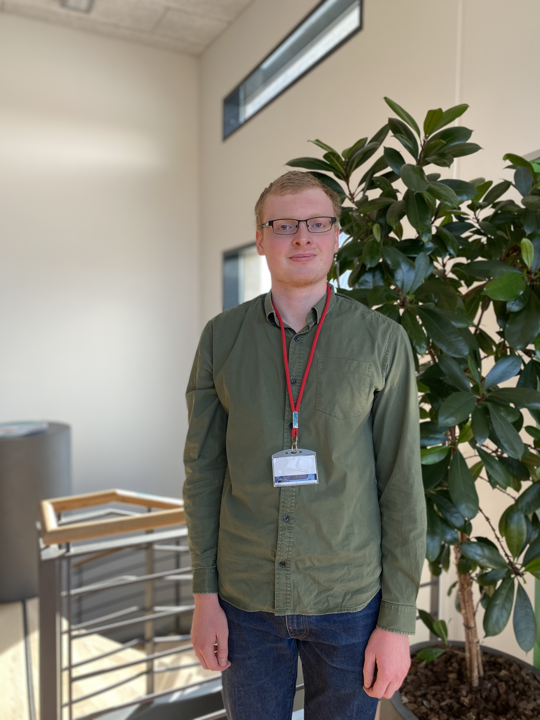
E-World
23-25 May
Essen
YOU ARE INVITED
TO VISIT US AT
STAND 527
HALL 2

Slide 39
questions?
CONTACT
Marni Jacobsen
• E-mail address: mjq@gasstorage.dk
• Tel. No. +45 30594137
Iliana Nygaard
• E-mail address: iny@gasstorage.dk
• Tel. No. +45 61243403

Slide 41
Current cases and pipeline
The Danish Utility Regulator
Energinet Shippers’ Forum
March 9, 2023
DUR/TERI/PELJ

Slide 42
Current Cases and Pipeline
Decisions:
Entry Capacity Conversion
    Final method application received 31st January
    Decision March 3rd, published March 7th
    Approved with certain conditions
Ongoing:
Offshore tariff complaints 2011-2021
    Expect decisions second half of 2023
    Comparison to market practice ongoing
    Rejection of part of fourth new complaint December 2022
Long and short term capacity quotas, Faxe and Ellund
    NC CAM, article 8.9
    Consultation on applications end December
Congestion management at IPs
    New regulation 2022/2576 (“Enhancing solidarity …”): TSO must offer underutilised capacity on MA, DA and WD basis
    Energinet seeks derogation (article14.7(c)). Must be applied before March 31st
    Consultation with URE, BNetzA, Ei
Balancing model issues
    DUR is following the situation
    Ongoing dialogue with Energinet

Slide 43
Recent publications and other news
Market Correction Mechanism:
(Council Regulation (EU) No 2022/2578)
ACER: Effect Assessment Report
March, 2023
(https://acer.europa.eu/gas/market-correction-mechanism)
ESMA: Effect Assessment
March, 2023
(https://www.esma.europa.eu/press-news/esma-news/esma-finds-mcm-had-no-measurable-impact-financial-markets-under-current-market)
Conclusions:
No discernable market impact, but may emerge if markets change
Other news:
Evaluation of Danish-Swedish wholesale gas market postponed
    ACER recommends evaluation of markets every three years as part of Gas Target Model
    Purpose: market design changes
    DK/S market last evaluated 2017
    In 2020 DUR and Ei decided to postpone to 2023 due to Tyra and Baltic Pipe
    Tyra now delayed till 2023/24

Slide 44
Questions?

Slide 45
Revenue cap regulation on Gas-TO

Slide 46

Structure of presetation
Status on regulation as of today
Quick note on terminology
Revenue cap – principles Components of a revenue cap
Regulatory proces
Efficiency requirement

Slide 47
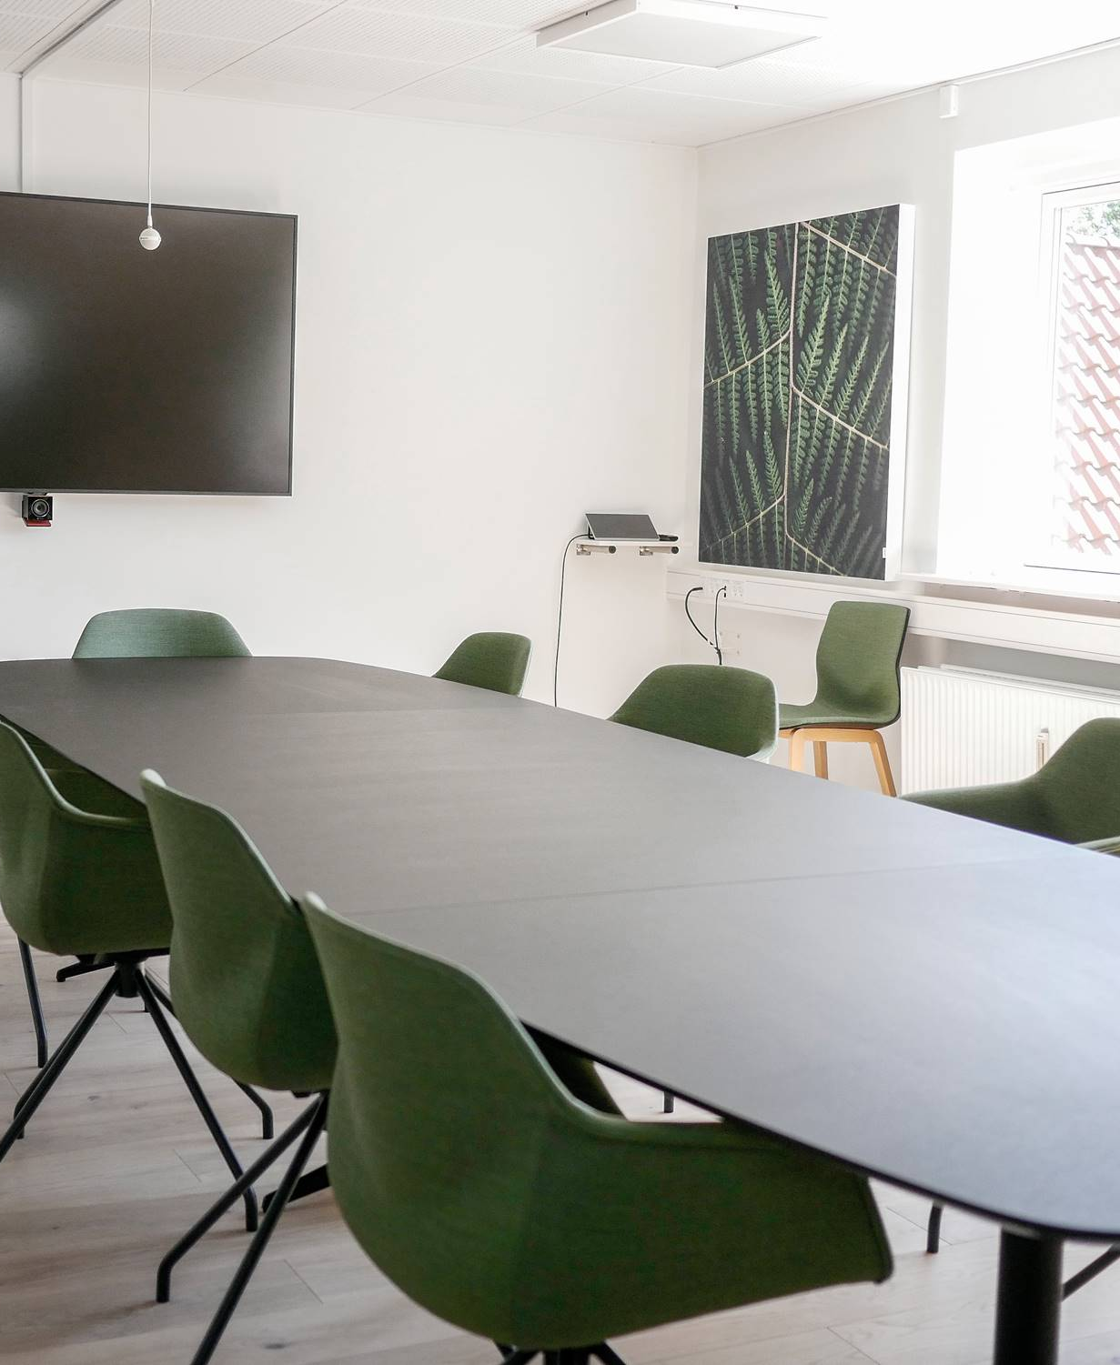
Quick note on terminology used in the talk
Law (lov) – Parlament (Folketinget)
Executive order (Bekendtgørelse) – secondary law issued by DUR or the ministry
Decision (afgørelse) – issued by DUR, administrative complains to ENK
TO: Transmission operator (systemejer)
SO: System operator (systemansvarlig)

Slide 48

The overall status of the economic regulation of GAS-T(S)O
With a legal change as of 28/12-2022, regulation of the GAS TSO has been split into a GAS-SO and a GAS-TO regulated activity.
The GAS-SO remains under existing regulation for 2023 and its future regulation will be clarified this year.
The current presentation focuses on the GAS-TO as it is currently under a revenue cap.

Slide 49

Revenue cap regulation: principles
Revenue cap approach
  Not realized cost, but a cap based on actual costs in the previous period and regulatory adjustments.
  Two year regulatory period, then recalculation (5 for electricity DSO, 4 for Gas DSO, 2 for electricity system operator)
  Implications:
    Incentive for efficiency gain
    Cost of capital to reflect risk for the company
    The company carries risk of increase costs in the period
Important notes:
  the revenue cap does not directly sets prices – this happens though the tarif proces (which is not my brief). No decision on a final revenue cap will be made till Q3 2024.

Slide 50

Components of the revenue cap (§3-7)
The revenue cap is based on cost from a reference period.
  OPEX plus depreciation (omkostningsramme)
  Cost of capital (forrentningsramme)
DUR can make a number of adjustments to the cap that reduce or increase the cap to take network and exogeniously caused changes in the period into account – including an adjustment based on a input price index (split between wage level increase in industry and a material index) (§9)
Note on depreciation: assets activated after 1. january 2023 used standard lifespans (set by DUR) and liniar depreciation profiles. Assets actived before 2023 uses Energinets current (as of the time of the issuance of the executive order) depreciation profiles. These profile cannot subseqently be changed.

Slide 51

Regulatory process
Before the regulatory year/period:
  Guidance of expected revenue caps: aid to set tarifs for Energinet (important: not a decision) (§8 – note §8 stk 4)
  Decision on cost of equity capital for the period: sets cost of equity as a RoR and a maximum equity cap (§18)
  Decision on efficiency requirements for the year (§10-§11)
In the year following the regulatory year DUR renders a decision on the corrected revenue cap for the previous year and any differences between actual and allow revenue is added to the difference account and handled according to §21
.
After the regulatory period, the revenue cap is recalculated based on actual realised costs (including cost of debt service) and the process starts again.

Slide 52

Efficiency requirements decision (§10, §11 and appendix 1)
Efficiency has two aspects: general and individual
The general aspect seeks to require the TSO to follow increases in productivity in comparable companies, the invidual seeks to require the TSO to ”catch up” with
Work on a method to set invidual efficiency requirments across Energinets regulated entities is underway – DUR and Energinet also participates in european TSO benchmarking work.
Due to lack of expected reinvestment in most of the GAS-TO´s depreciation costs are not subject to effeciency requirements….
  …but is also not adjusted for inflation like other costs.

Slide 53

Cost of equity decision (§18)
Currently under the complains proces.
The broad outline: COE rate, maximum equity and debt service cost passthrough.
Decisions before regulatory period

Slide 54
Questions?

Slide 55

Capacity
Lasse Ellebæk Krogh, Energinet

Slide 56
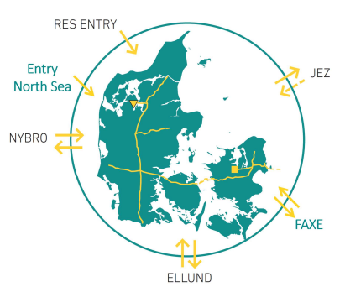
Capacity conversion between entry points
Approved by Danish Utility Regulator
Available for April auction
Introducing more flexibility to the system
The Service
Capacity can be re-utilised between the points Entry Ellund, Entry North Sea, Entry Faxe and Entry Nybro.
If you are successful in booking capacity at one entry point (without over-demand), you will be able to convert existing entry capacity contract to the new contract.
  Why
  To increase security of supply for Danish consumers in an uncertain time in the gas market
  To increase efficiency in the use of the system

Slide 57
Capacity conversion between entry points
The approved methodology
The service applies to Annual, Quarterly and Monthly Capacity.
If there is over-demand in an auction it is not possible for Energinet to offer the entry capacity conversion service for the period covered by the given product.
Thus, a request can only be accepted for one month at a time (also for quarterly and yearly products).
If you wish to use the service, please submit your request not later than 3 Business Days after the conclusion of the monthly capacity auction to gasinfo@energinet.dk

Slide 58
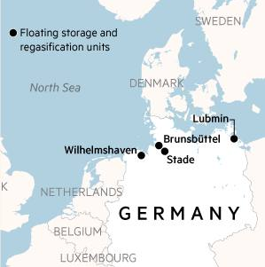
dialogue with Gasunie Deutschland about southbound capacity
LNG facilities in North-West Germany can potentially influence the southbound capacity from Denmark towards Germany
The gas systems in Germany is affected by changed gas flows after the Russian invasion of Ukraine.
The previous deliveries of gas from the east are now largely replaced by deliveries of gas from the west – especially in the form of LNG.
Energinet is in dialogue with Gasunie Deutschland and works to ensure the capacity towards Germany is not reduced.
If you are interested in southbound capacity – we encourage you to let us and Gasunie know so that market signals may be considered!
Source: ft.com

Slide 59
Incremental Capacity Process
You are encouraged to send your demands for Incremental Capacities in the Danish gas system, so this can be considered in the overall planning.
April
May
June
July
August
September
October
…
Annual auction
Demand assessment report
Energinet gathers first demand signals via dialogue with the market
(April-May)
Energinet will forward Demand Assessment Questionnaires after annual auction
(3 July 2023)
Market participants can indicate non-binding demand until 8 weeks after annual auction
(28 August 2023)
Report concludes continuation
(23 October 2023)
Next steps include:
  Design phase
  Market consultation
  Decision by DUR
Point | Entry North Sea | Entry Nybro | Entry Faxe | Entry Ellund* | Entry RES | Entry Storage | Exit Faxe | Exit Ellund | Exit Storage
Explanation | Imports from Norway | Imports from Norway + Danish North Sea | Imports from Poland | Imports from Germany | Biomethane injection | Withdrawal from Danish storage | Exports to Poland | Exports to Germany | Injection to Danish storage
Expected possible capacity (GWh/h) | 13.4 | 20.3 | 3.8 | 7.7 | According to socioeconomic valuation | 8.2 | 13.4 | 10.0 | 4.2
* Entry Ellund capacity is expected to be 7.7 GWh( on a long-term basis)

Slide 60
Contact: ltk@energinet.dk

Slide 61
Balancing
Christian Rutherford, Energinet

Slide 62
Status on the new balancing model
Operational and billing status since last Shippers Forum
Balancing model as of 9th of March
IT-status
Data quality
Status on billing
Major issue with matching solved early January
Confirmation feature for smoothing in place, and different issues have been solved (e.g., wrong placement of trades at night)
General status considered positive, still new issues occur that needs solving + new possible features
It is Energinet’s general impression that data quality has improved during the past months, based on general communication with shippers and stand-up meetings
Large focus on data errors from certain Swedish distribution companies, where we still see large data errors frequently
Extensive test activity going on these days to ensure balancing invoices as soon as possible
Invoicing of first months will be done in 2 steps: 1) Focus on invoicing based on permanent solution, and 2) investigating and possibly neutralizing certain days/periods

Slide 63

Expectation on green zone flexibility
Energinet will always optimize the size the green zone, to ensure that as much flexibility from the system is put towards the market
Flexibility was generally increased on 14 February, based on operational arrangement with adjacent system
There can be a need to reduce the current flexibility temporarily, due to operational reasons
The average size of the green zone will increase as known obstacles are solved
Increase of green zone flexibility
Temporary reduction
The system flexibility is characterized by normality
Yellow zone
Yellow zone
Yellow zone
Upper band(+x)
0
Green zone
Lower band (-x)
Green zone
Green zone
Yellow zone
Yellow zone
Yellow zone
February 2023
Spring 2023
Gradually the following months

Slide 64
Communication and evaluation
Weekly stand-up meetings every week since December
Evaluation of the Balancing model, based on the first 5 months of operation
Stand-up meetings and evaluation of balancing model
Weekly stand-up meetings
Evaluation of balancing model
Since last Shippers Forum in December, Energinet has hosted weekly stand-up meetings, to discuss progress on balancing model issues
Meetings are well attended, with plus 20 participants every week
It is Energinet’s impression that latest meetings show a positive trend, with less new issues
Weekly meetings are so far planned until end-May – Energinet will discuss relevance and frequency with the participants
Based on the method approval of the balancing model, Energinet are obliged to evaluate the balancing model based on dialogue with the market (page 54-56): Godkendelse af metodeændring til balancemodellen på gasområdet (forsyningstilsynet.dk)
Energinet will involve the market in 2 steps; 1) ask for first written comments until 10 April; and 2) ask for written comments to the following evaluation report, which is expected around mid-May
Deadline for forwarding the final evaluation report to DUR is 1 July

Slide 65
Contact: cru@energinet.dk

Slide 66

Final Remarks
Clement Johan Ulrichsen, Energinet

